Slide 1
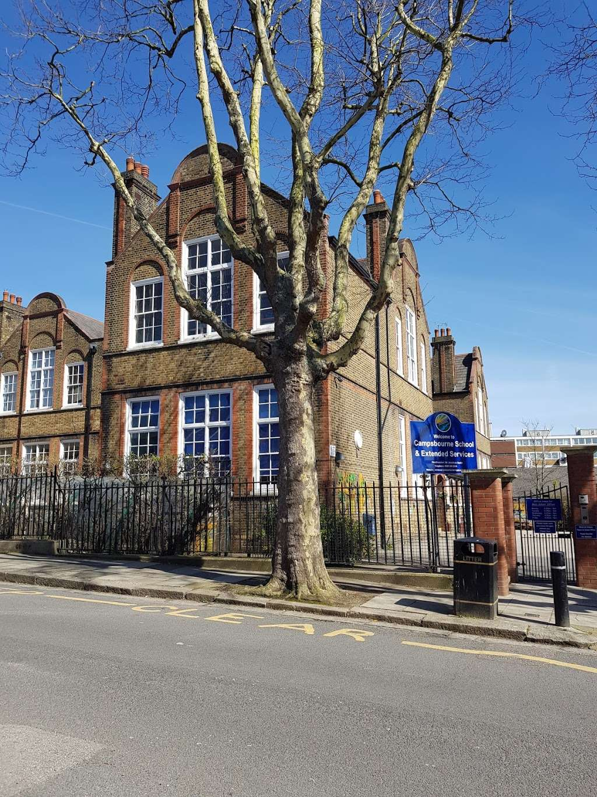
What we will cover today:
Staff in Year 2
What your child will need
School uniform
Routines (a typical day)
Overview of core subjects
Assessment
Wider curriculum
Trips
PE / Swimming
Behaviour and ClassDojo
Drop off/Pick up
Communicating with the teachers
Support at home

Slide 2
Staff in Year 2
2 Moore:
Sinead Healy
2 Hepworth:
Daisy Hill

Slide 3
What does my child need to bring?
Coat/raincoat
Book Bag
PE / Swimming Kit on the day they need it.
Water bottle (with their name on it)
Packed lunch if required
Fruit snack
Book from home
Please label EVERYTHING!
No toys or items from home please (unless specifically requested by class teacher).

Slide 4
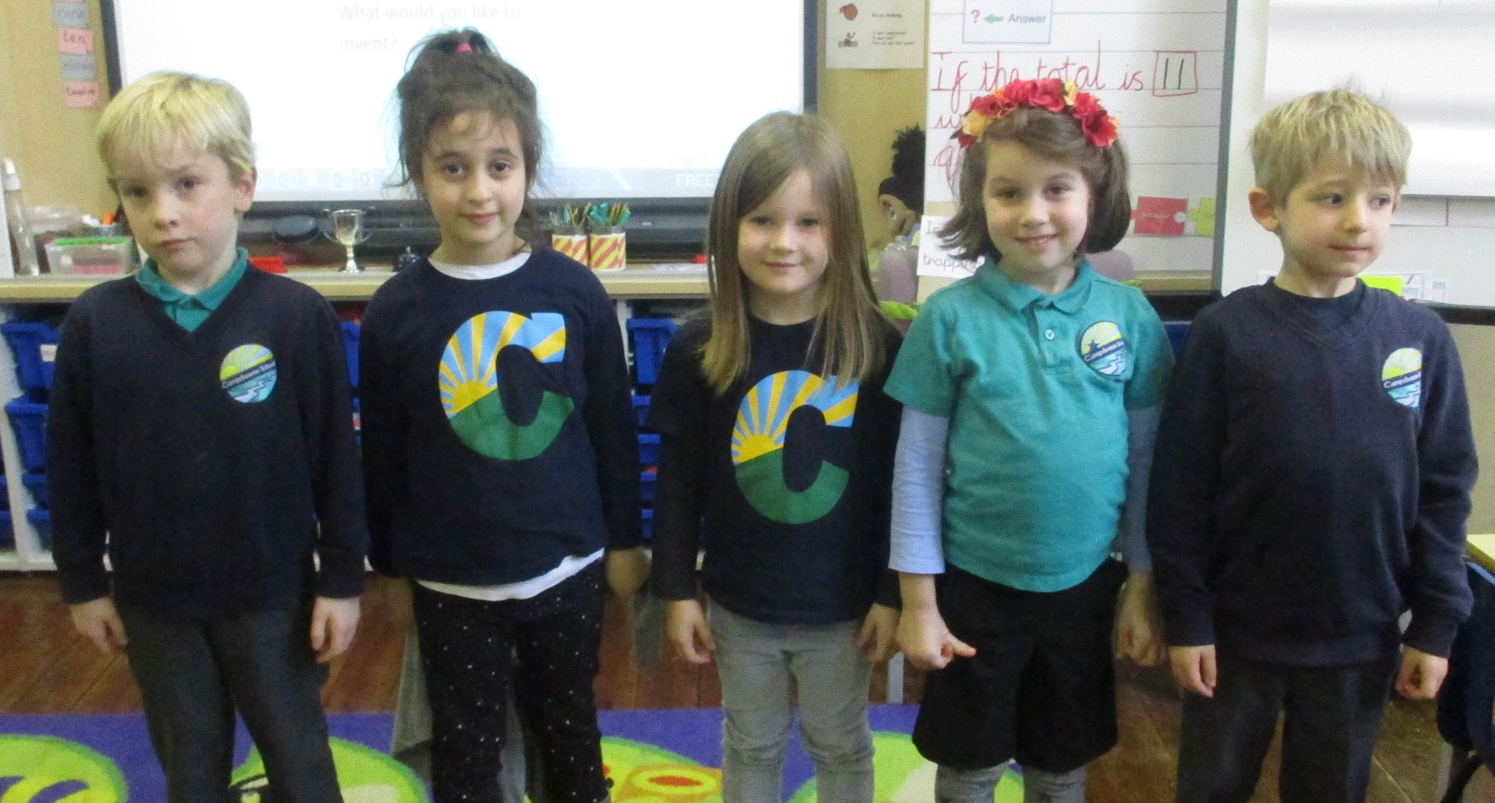
School Uniform
All children are expected to wear school uniform:
Campsbourne t-shirt, polo shirt, jumper or cardigan.
Sensible and comfortable shoes (that they can fasten themselves!).
Please label all items of clothing!

Slide 5
PE Uniform
Children should wear their PE kit to school on their PE days. This would mean children could wear leggings/tracksuit bottoms or shorts and trainers on the days that they have PE. They must wear their Campsbourne top to school, as following the school uniform policy, but can bring a t-shirt to change into for their PE session. This does not have to be a Campsbourne top but they must change back into their Campsbourne top after their PE session. Strictly no Football kits or tops are allowed.
Gymnastics and dance should be done in bare feet for health and safety reasons. In the cases that children have a verruca or similar, children can wear plimsols for their dance and gymnastics sessions.
Jewellery and dangly earrings should not be worn for PE and should be removed. Stud earrings are fine. This is in line with health and safety.

Slide 6
Routines (a typical day)
Registration
Assembly
Maths
Break – ( a fruit snack)
Sounds Write
Guided Reading/Phonics reading groups
Literacy (Talk 4 Writing)
Lunch
Foundation subjects
Afternoon play
Foundation subjects
Other staff
Music – Jeannie
Art – Siobhan
On a Wednesday we will not be present at home time.
Swimming - Andy

Slide 7

At Campsbourne, we teach the White Rose maths program to the children.
Children develop a deeper understanding over time through concrete and abstract learning opportunities whilst applying mathematical concepts to a wide range of reasoning problems.

Slide 8

Sounds Write
Sounds-Write is how we teach reading, spelling and writing.
Children receive daily Sounds-Write lessons.
In Year 2 to Year 6 the lessons focus on spelling.
We focus on building words using the different sounds before moving onto polysyllabic words.

Slide 9
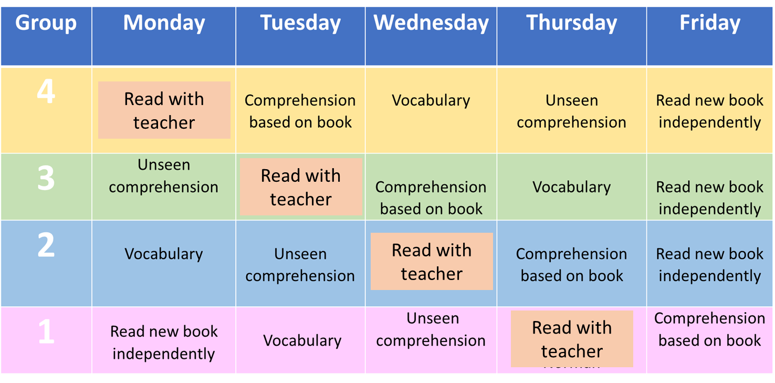
Guided Reading
Children’s guided reading books are changed every Friday, you will also receive a book to write in.
2 Moore visit the library every other Friday
2 Hepworth visit the library every other Thursday
The focus of reading in year 2 is on comprehension as well as fluency. Please do not be alarmed if your child has already read the text they bring home.
N.B. Phonics based reading groups for those children who need a little more practise.

Slide 10

Across the school we teach literacy through our Talk for Writing program.
Enables children to imitate the key language they need for a particular topic orally before they try reading and analysing it.
We imitate, innovate and invent a text.
You can find out more information at www.talk4writing.com/about

Slide 11
Assessment (Year 2)
On-going
Weekly spelling challenges
End of Autumn and Summer assessments
SATs are no longer compulsory

Slide 12
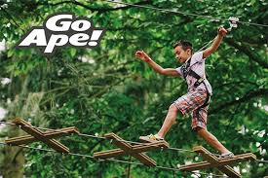

Educational Visits / Trips and Performances
Autumn term: Alexandra Palace/Park
Spring term: Science Museum
Summer term: Go Ape

Slide 13
Physical Education
Swimming: Swaps every half term between group A and B
Hepworth – Thursday
Moore - Friday
PE:
Moore – Monday for all (gym) Friday (for those who are not swimming, outside)
Hepworth – Wednesday for all (gym) Thursday (for those who are not swimming , outside)

Slide 14
Behaviour
Golden stars – can be collected by the whole class for lining up at the end of playtimes or lunchtime.
50 marbles in a jar – classes can collect 50 marbles in a jar for following the golden rules and independent work.
Dojo Points – are awarded to individual/groups/whole class for showing excellent behaviour and completing great work. Every 100 dojos, your child will get a certificate.
Anchor approach - We are using the anchor approach as our behaviour policy. E.g. positive relationships, proximity, calm corner

Slide 15
Drop off/ Pick Up
Start at 8.55am and finish at 3.30pm.
All parents should remain behind the cones.
Please make sure your child has told us they are leaving the line at the end of the day.
If on occasion, you arrange another parent / family friend / family member to collect your child, please make sure you let the office know before 3pm. We will not be sending children home with adults other than you if we don’t get a clear message from office staff.

Slide 16
Communicating with the teachers
If you need to talk to your class teacher, please let them know at the beginning/end of the day.
N.B. We will not be using the Dojo app or direct emails for contact between us.
If you need to contact the school, please email admin@campsbourne.haringey.sch.uk The office will make sure your message reaches the correct person quickly.

Slide 17

Home support
Homework (home-learning letters on a Friday)
Spellings
Quick maths/recall of number facts (WRM app, Hit the Button)
Reading (listening to and reading to)
Talking and playing games (cards, chess, board games).
Real life experience: e.g. shopping and cooking.

Slide 18
Questions?

