Slide 1

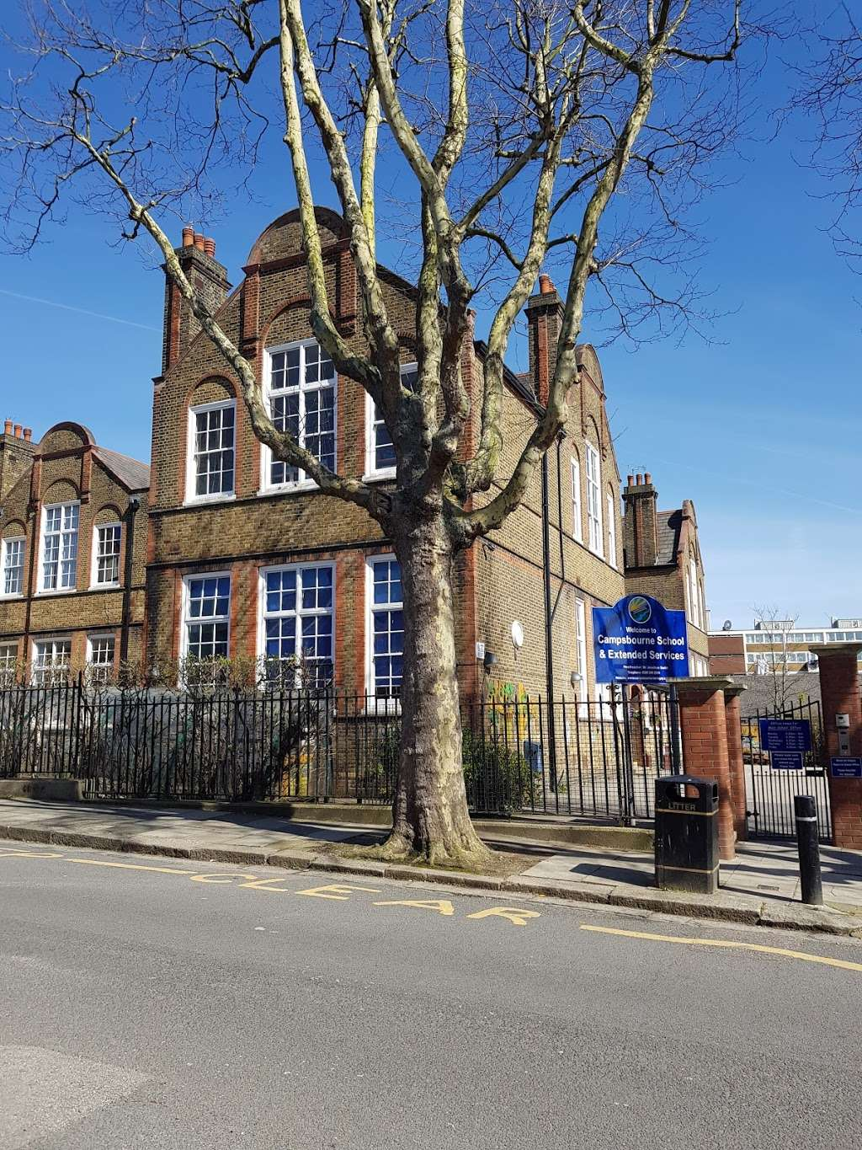
Welcome to Year 4 Meet the Teacher

Slide 2
Staff in Year 4
Kapoor
Mr Ershan
Whiteread
Miss Dimopoulos
Kira
TA

Slide 3
What does my child need to bring to school?
Coat
Book Bag with a reading book once they have been given one
Water bottle with their name on it
Packed Lunch if they are packed lunch. Please refer to the food policy for guidance on items that should not be brought in. E.g. crisps/chocolate.
No toys or stationary should be brought in from home, unless specifically requested by class teacher.

Slide 4

In years 3 to 6, we teach the White Rose maths program to the children. This approach to teaching maths ensures that children develop a deeper conceptual understanding over time. This is done through concrete and abstract learning opportunities whilst also having the opportunity to apply mathematical concepts to a wide range of problem solving and reasoning problems.

Slide 5

Across the school we teach literacy through our Talk for Writing program.
Enables children to imitate the key language they need for a particular topic orally before they try reading and analysing it.
Through fun activities that help them rehearse the tune of the language they need, followed by shared writing to show them how to craft their writing, children are helped to write in the same style.
You can find out more information at www.talk4writing.com/about

Slide 6
Destination Reader is the KS2 program to teach reading.
Takes place Tuesday to Friday at the same time. 10.30am to 11.15am.
Destination Reader focuses on various strategies that help children to become more fluent in their reading, and helps develop a love of reading.
There is lots of reinforcement of key words because children are reading them everyday.
The books are enjoyable stories which encourage children to read for pleasure.
Interventions may continue with Kira for the children who were in DSR last year.

Slide 7

Sounds-Write is a quality first phonics programme and is how we teach reading, spelling and writing.
Children receive Sounds-Write lessons four times a week focusing on spelling.
It will also be used as an intervention or catch-up programme.

Slide 8
P.E
Kapoor
Tuesday – Gymnastics
Friday – Netball
Whiteread
Tuesday – Gymnastics
Friday – Swimming
Children should bring the appropriate kit for their lessons:
Swimming: swimwear, swim hat and a towel.
P.E Kit: shorts/joggers, t-shirt, sports trainers.

Slide 9

Wider Curriculum
The children will receive a rich curriculum consisting of History, Geography, PSHE, Science, RE, PE, Art, Music, Computing, Food Education, Design and Technology and Spanish.
We will be teaching these subjects mainly in the afternoons, where we will focus on developing the children’s independence and teamwork.

Slide 10
History:
Romans
Water Systems
Ancient Greece
PSHE:
Diversity & Communities
Healthy & Safer Lifestyles
Managing Change
RSE (Human life cycle)- a separate letter will be sent home in June 2026.
RE:
Buddhism
Christianity
Science:
Living things
Electricity
States of matter
Sounds
Animals including humans
Geography:
Rainforest
Water cycles
Design & Technology:
Linkages and Levers
Electricity
Taste Education
Computing:
The Internet
Data logging
Photo editing
Repetition in games
Repetition in shapes
Audio production

Slide 11
Changes to the Weekly Timetable
The children will have music and art lessons on a Monday taught by Jeannie and Siobhan.
Each class will have either art or music and then swap the following week.

Slide 12
Accelerated Reader
Accelerated reader is used in KS2 to promote reading at home and within school
MOST books within school have an AR code on them
Children can use their own logins to complete a quiz on Accelerated Reader
If your child achieves 80% or more, they will earn a certificate.
After scoring 80% on 10 or more books, the children will be given a certificate in class.
Please note: Not all books are on the Accelerated reader system, so your child cannot be tested on all books they read.
Children will have the opportunity to complete Accelerated reader quizzes during assemblies.

Slide 13
Assessment (Years 3 to 6)
Children are assessed daily in lessons through observations, marking and class discussions.
Children complete times tables challenges and arithmetic papers in class during Monday maths lessons.
Formal assessments will take place twice a year at the end of the Autumn (1-5th December 2025) and Summer terms.

Slide 14
National Testing
Multiplication tables check
Schools must administer the multiplication tables check within the 2-week period from Monday 1 June 2026.
The MTC is a statutory, online assessment taken by all Year 4 pupils.
Pupils answer 25 random multiplication questions from 2×2 to 12×12.
Most children have six seconds to answer each question.
Results help teachers identify which pupils are fluent and which may need additional support, but there is no pass or fail mark

Slide 15
Weekly challenges
Friday – Spelling challenge (these will be sent out on a Friday, after we have explored them as a class all week)
Times tables challenge (children progress through all the times tables at their own speed and earn badges)
3a=blue
6a=bronze
9= silver
12=gold
Expected progression:
Year 3
Year 4
Year 5
Year 6

Slide 16

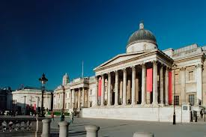
Educational Visits / Trips and Performances
We are hoping to have lots of fun trips this year! Previously we have visited the Science Museum, the National Gallery and a church!

Slide 17
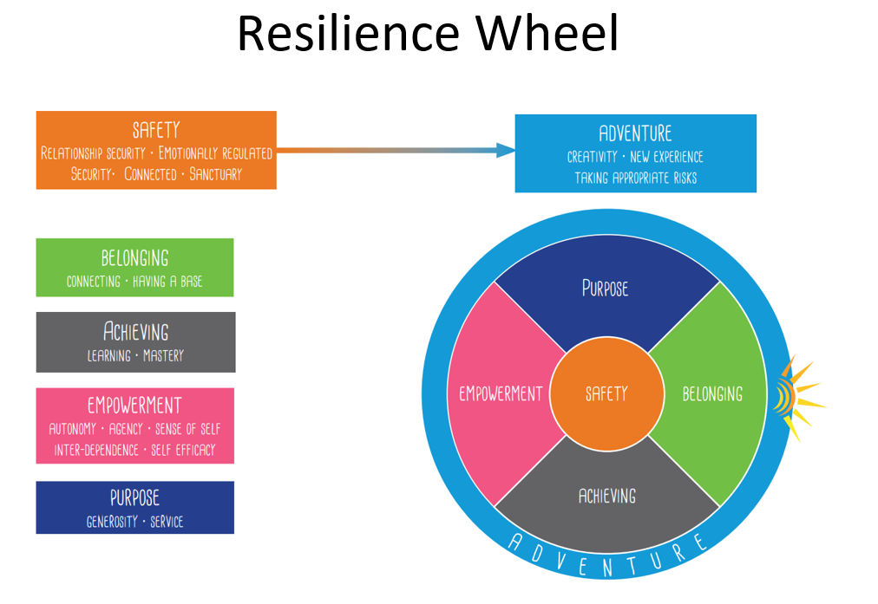
Behaviour
The school has recently adopted the Anchor Approach towards behaviour.
This means that there is no longer a traffic light system in the classroom.
Children will have a restorative conversation if they are not following the school rules that are in place to keep everyone safe.

Slide 18

Class Dojo
The school will continue to use Class Dojo’s as a way of individually rewarding students, but will not be sharing pictures or videos on this platform. .
Mr Smith’s reasoning:
“Last week we trialled the use of Class Dojo to communicate with parents sharing images and videos of the children in class. The number of parents who signed up for this was very low and does not justify the time required by administrative staff to set up and maintain accounts or the time which teachers spend taking pictures / videos etc and uploading them. We believe that teaches time is best spent teaching the children and have therefore decided not to offer this service in future but will continue to communicate about what your child is learning and exciting events which are communicated to you via weekly newsletters, homework letters and curriculum newsletters.”

Slide 19
Pick Up
If on occasions you arrange another parent / family friend / family member to collect your child, please make sure you let the office know by lunchtime (1.30pm) where possible. We will not be sending children home with adults other than you if we don’t get a clear message from office staff.

Slide 20
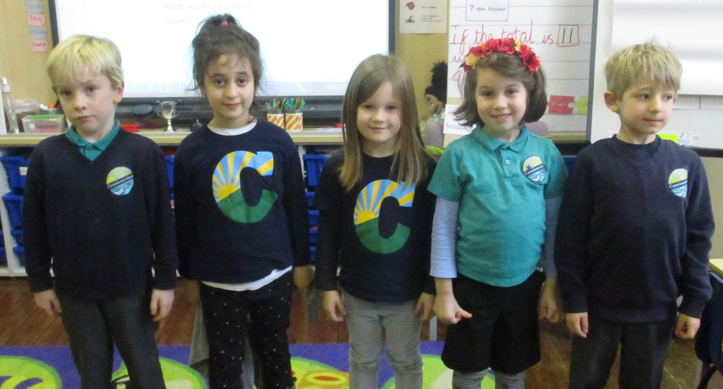
School Uniform
All children are expected to wear school uniform:
Campsbourne t-shirt, polo shirt, jumper or cardigan.
Sensible and comfortable shoes.
Please label all items of clothing!

Slide 21
Q&A

