Slide 1

Zones of Regulation (Early Years)

Slide 2
Aim
Overview of self-regulation
To understand how ‘The Zones of Regulation’ works
Self-regulation tools
Calming techniques
Sensory supports
Thinking strategies

Slide 3
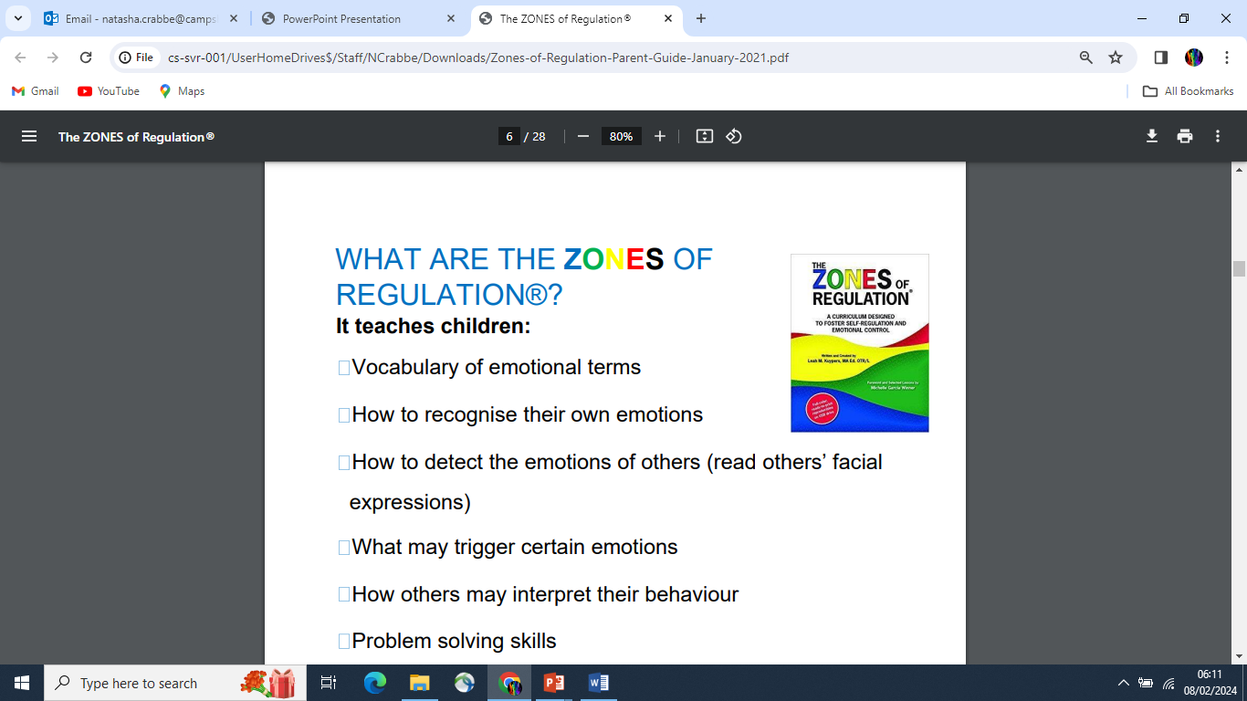

Slide 4
Early Year Foundation Stage (EYFS)
Research shows that from birth, experiences and adult responses influence how children self-regulate and deal with emotions. Meeting children’s emotions is critical, even when some are harder to understand or when they evoke strong feelings in you.
Behaviour can be an expression of feelings or emotions. To help children make sense of this, and have the best effect, approach them with empathy, supporting and guiding them to identify and deal with their emotions.

Slide 5
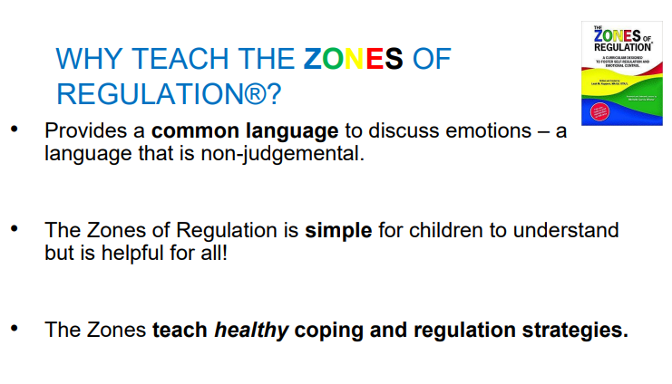

Slide 6
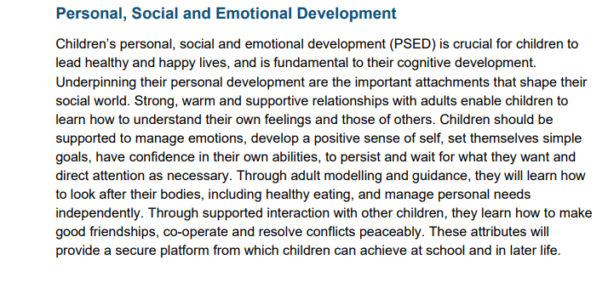
Early Years Foundation Stage

Slide 7
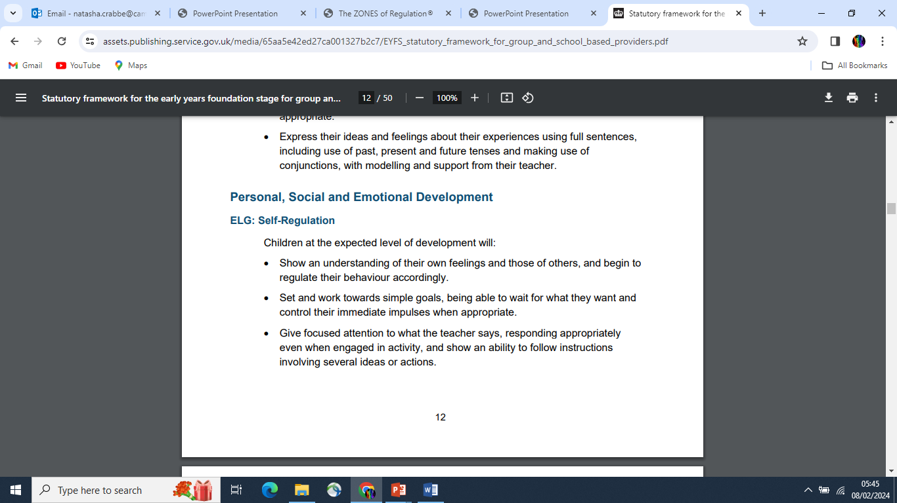
Early Years Foundation Stage

Slide 8
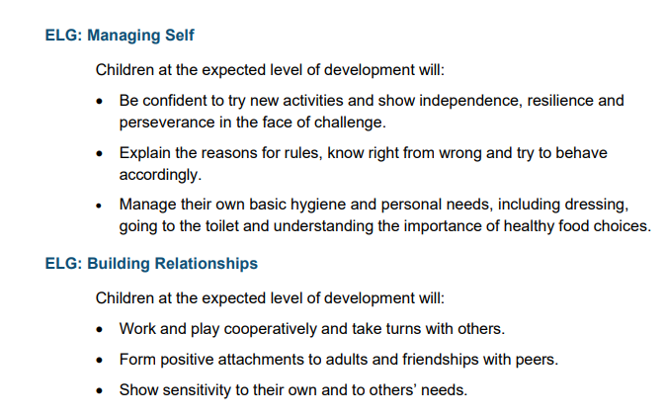

Slide 9
Definition of self-regulation
“…it is defined as the capacity to manage one’s thoughts, feelings and actions in adaptive and flexible ways across a range of contexts.” Jude Nicholas
It encompasses:
• Self-control
• Resilience
• Self-management
• Anger management
• Impulse control
• Sensory regulation

Slide 10
Why is self regulation important?
Life is 10% what happens to us and 90% how we react to it. Charles Swindoll
Research has found that higher academic achievement is more likely when interventions include self-regulation components.
Typically, children who can self-regulate will turn into teens and future adults who can also self-regulate.

Slide 11
A person who can self-regulate is able to:
• Remain CALM AND ORANISED in a stressful situation. (Executive Functions)
• Cheer themselves up after a disappointment. (Emotional Regulation)
• Knows when they are experiencing sensory overload and can make adjustments.
(Sensory processing)
• Understands when it is appropriate to cheer and shout and when to be quiet.
(Social cognition)

Slide 12
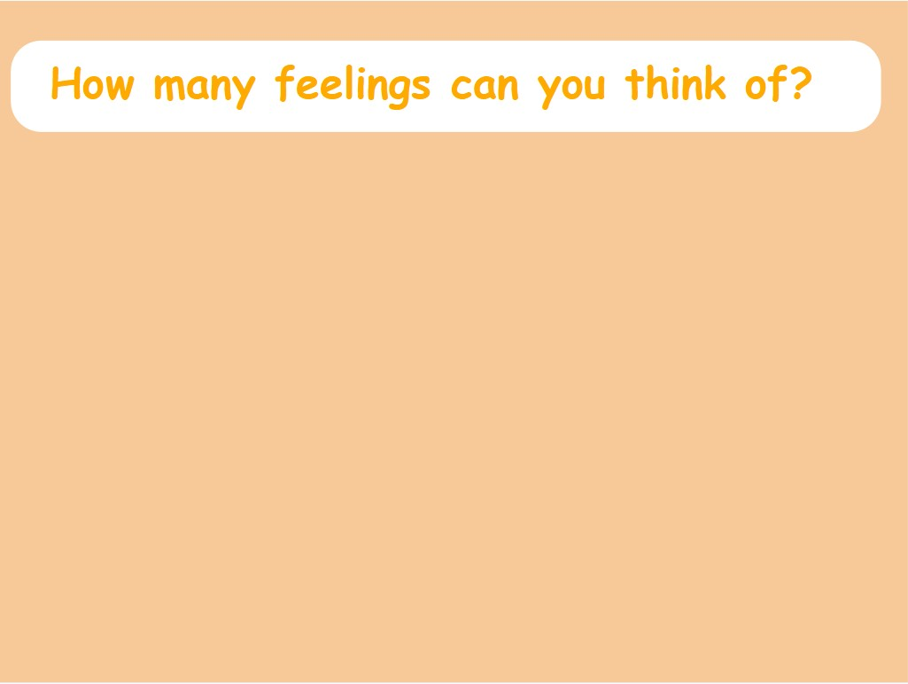
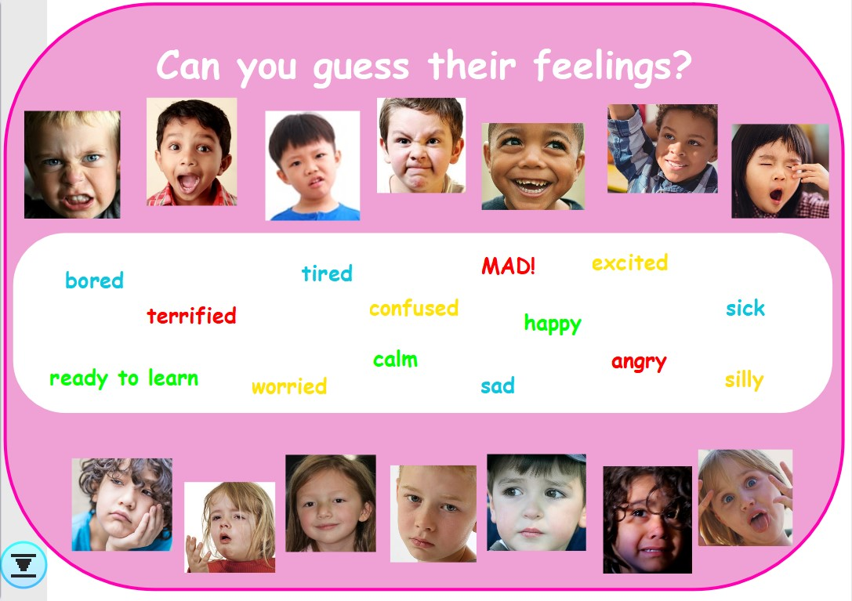
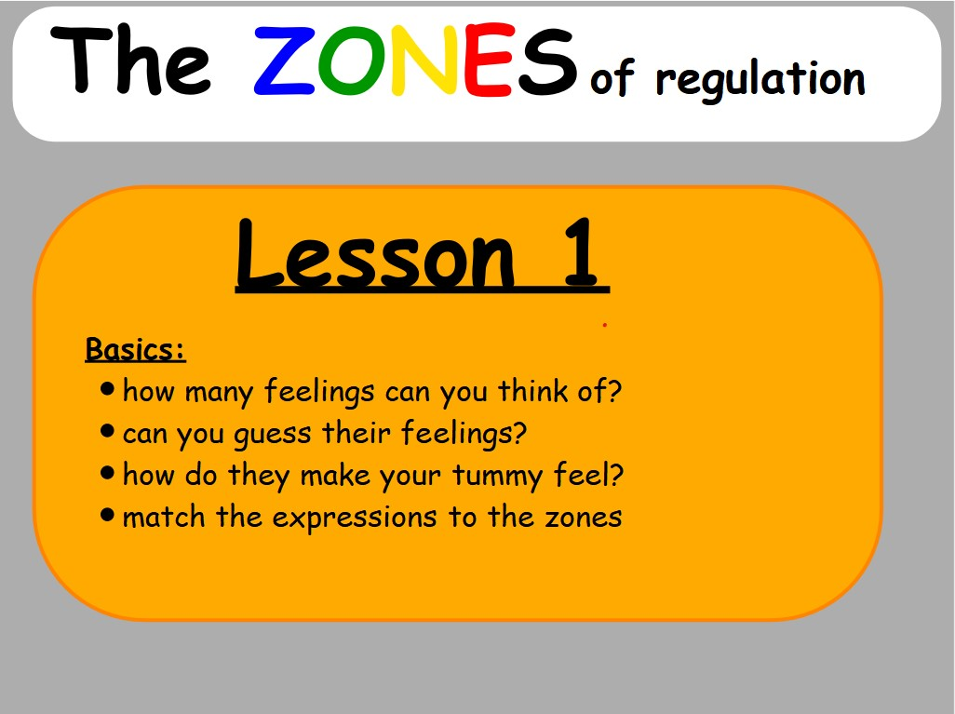
The Zones of regulation approach in Campsbourne School

Slide 13
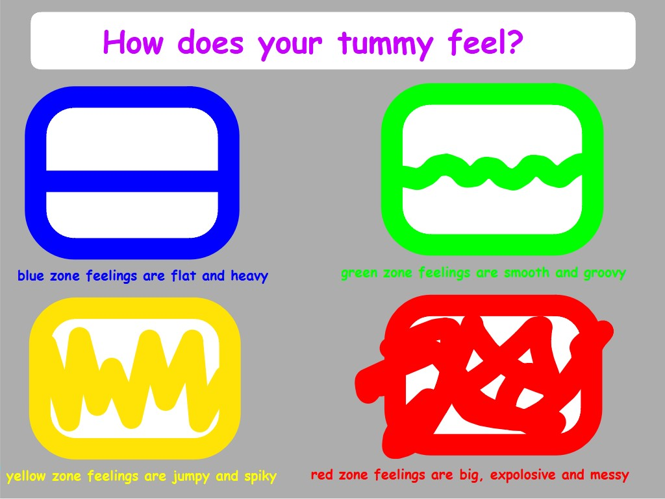

Slide 14
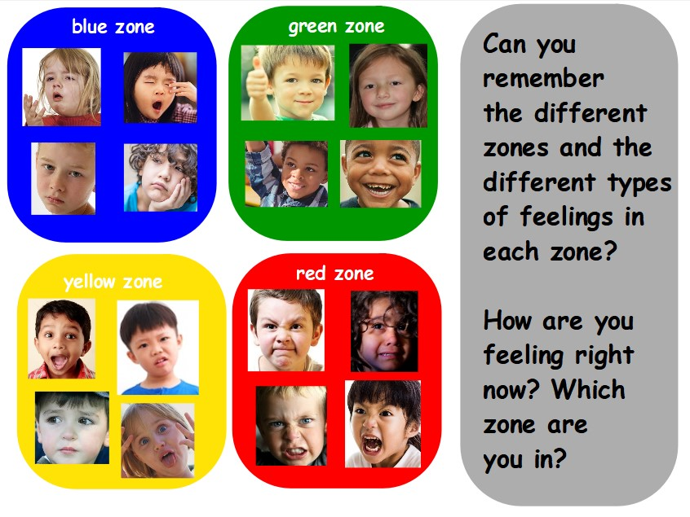
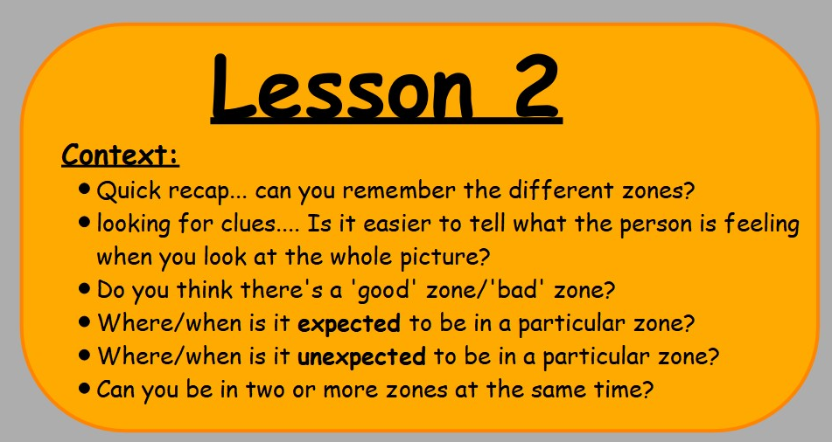
The Zones of regulation approach in Campsbourne School

Slide 15
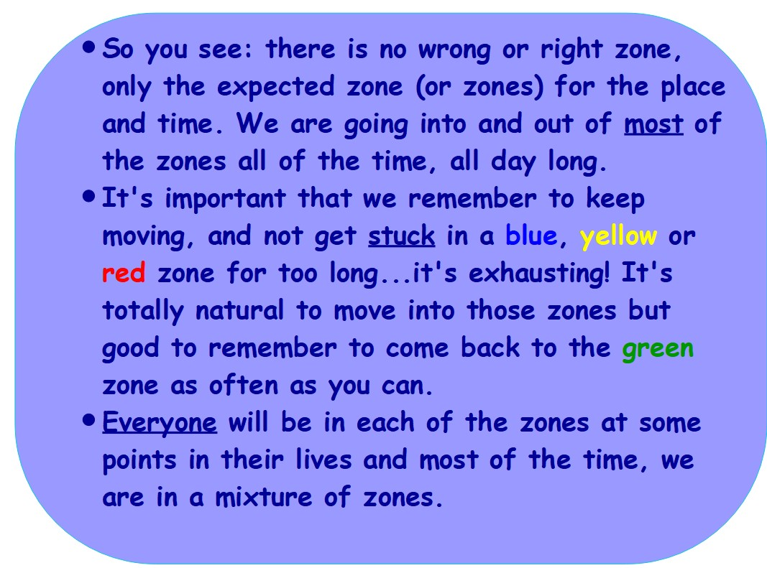
The Zones of regulation approach in Campsbourne School

Slide 16
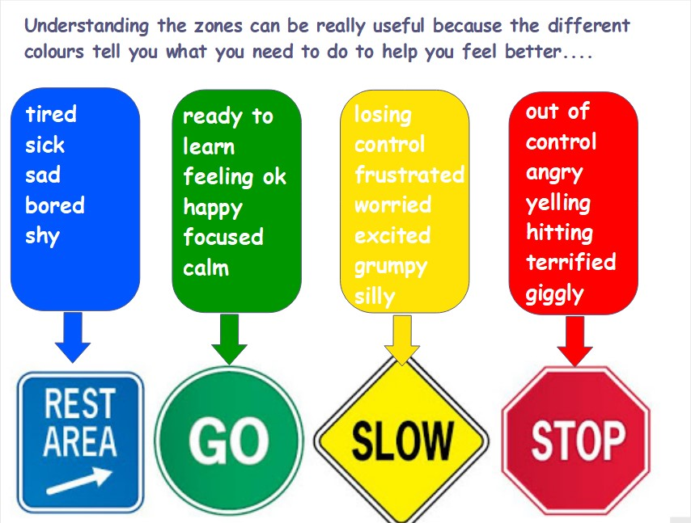
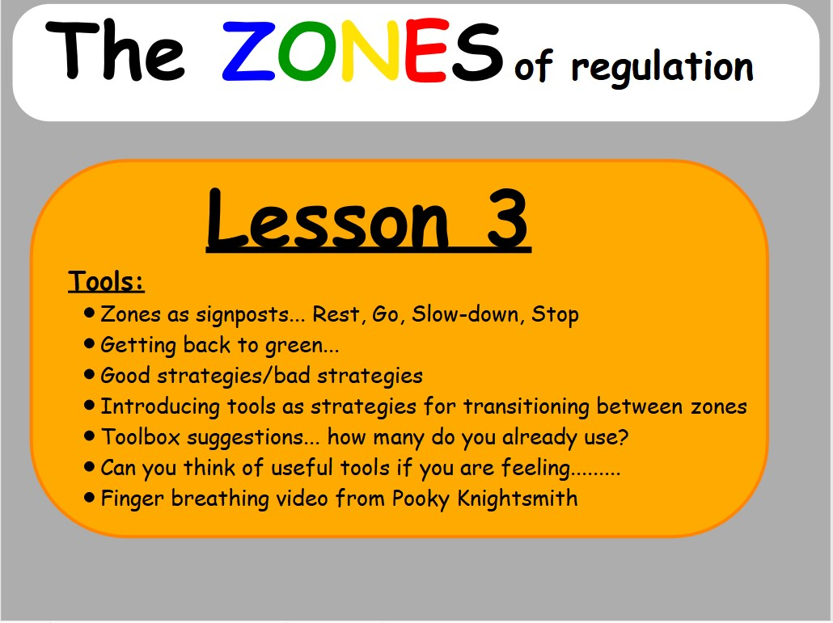
The Zones of regulation approach in Campsbourne School

Slide 17
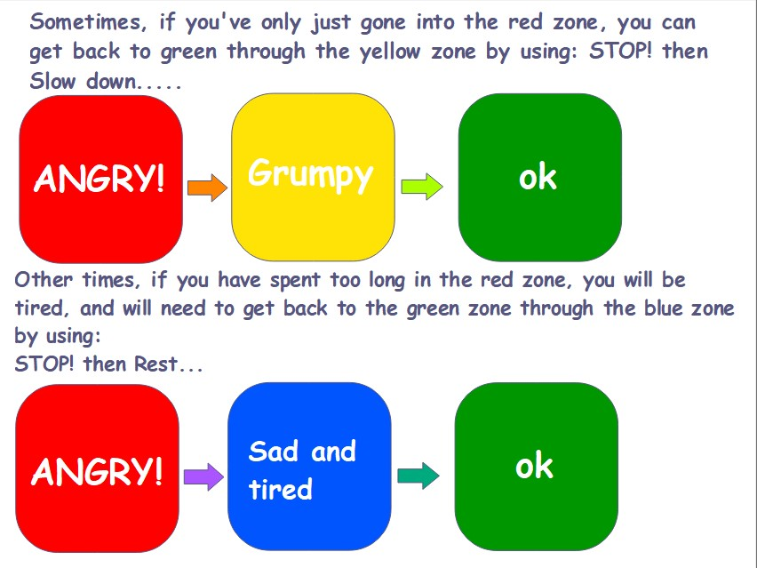
The Zones of regulation approach in Campsbourne School

Slide 18
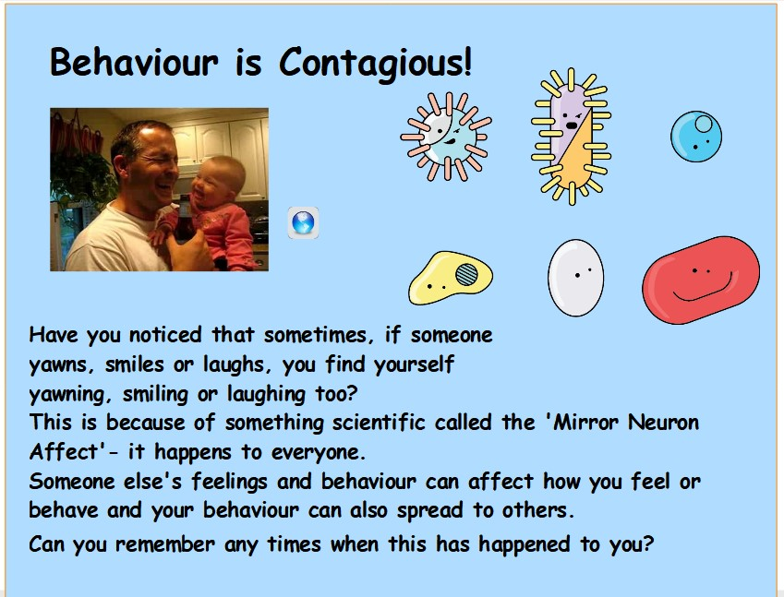

Slide 19
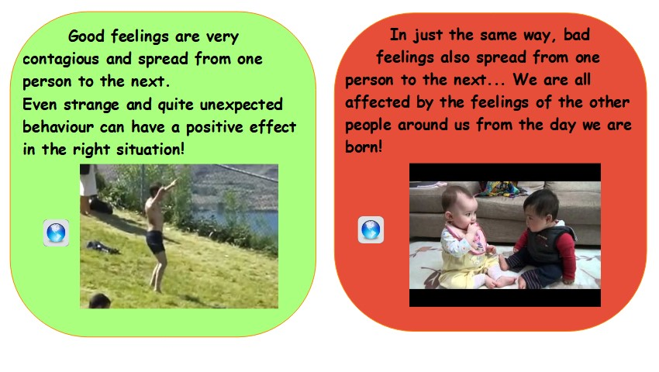

Slide 20
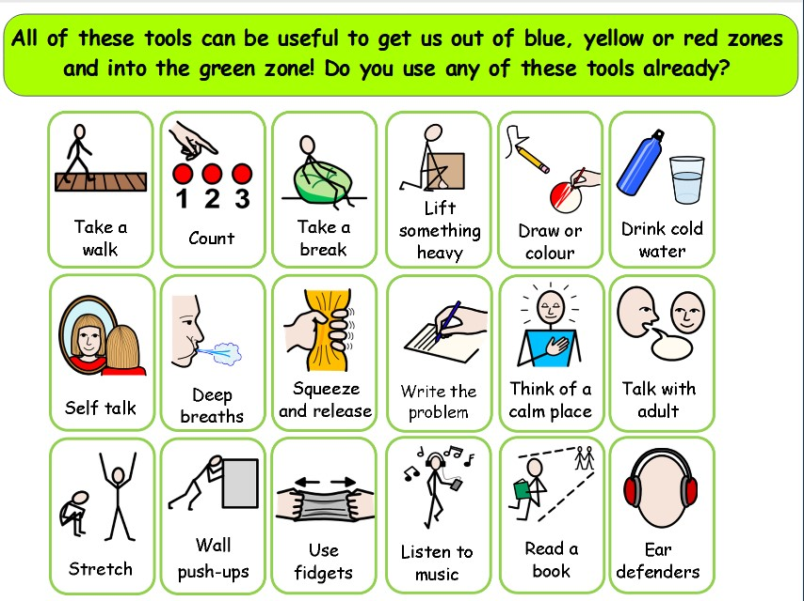
The Zones of regulation approach in Campsbourne School

Slide 21
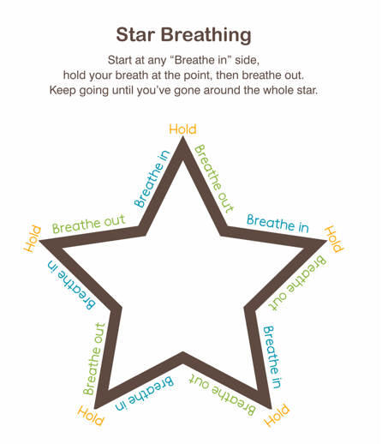
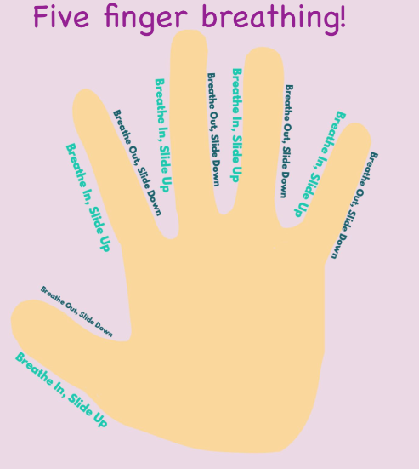
The Zones of regulation approach in Campsbourne School

Slide 22
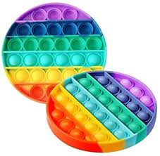
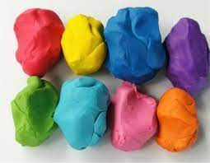
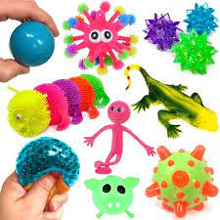
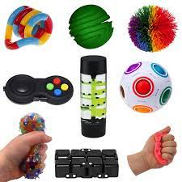
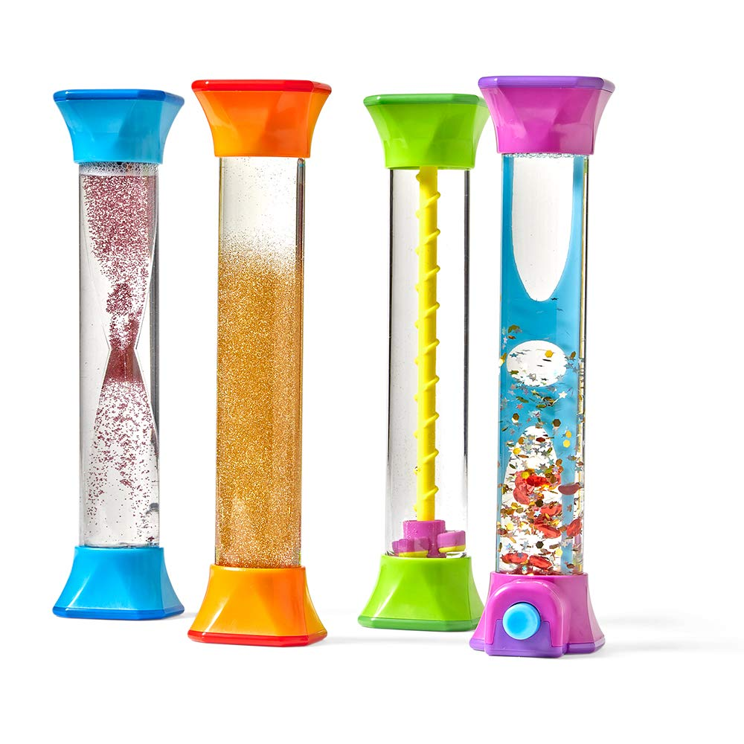
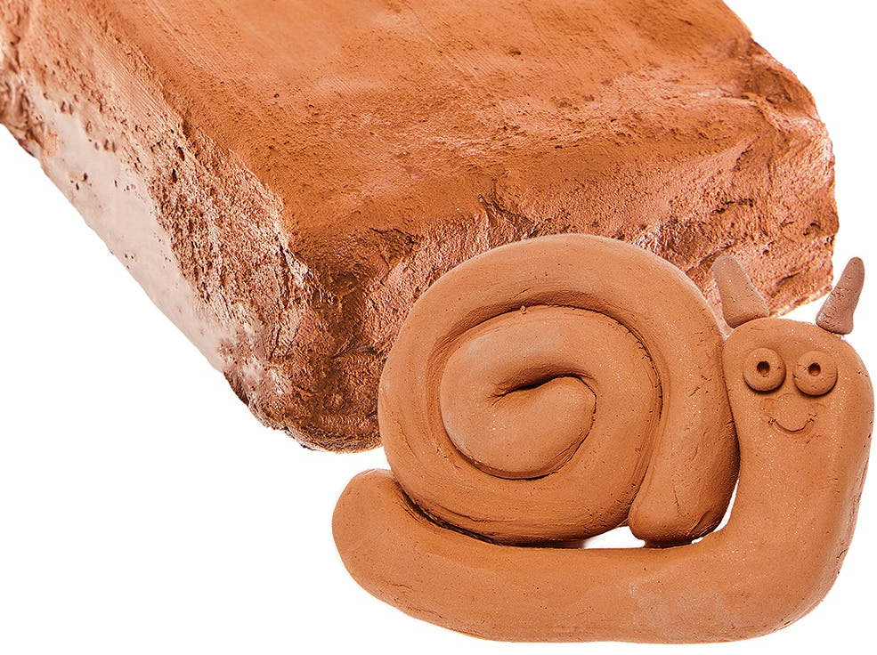
The Zones of regulation approach in Campsbourne School
Sensory support

Slide 23
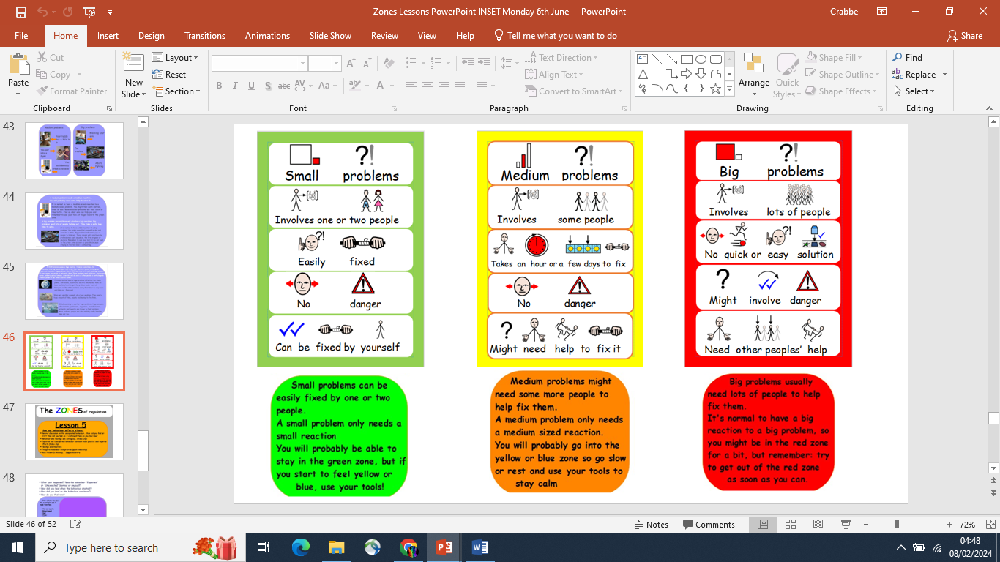
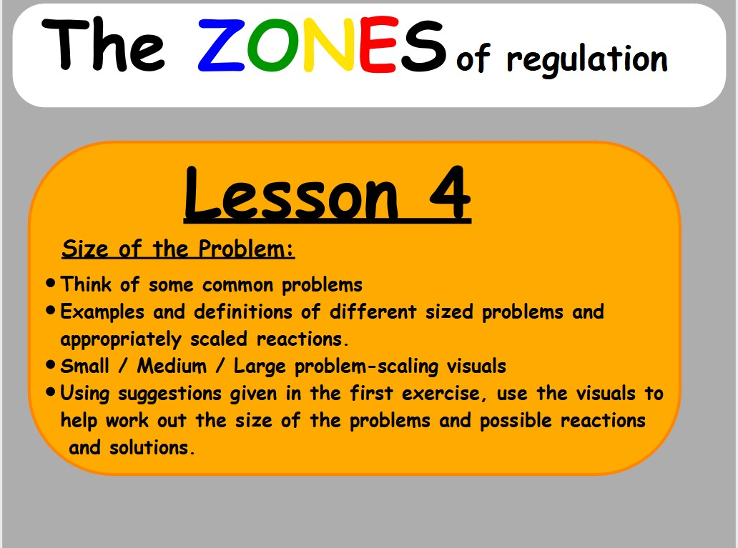
The Zones of regulation approach in Campsbourne School

Slide 24
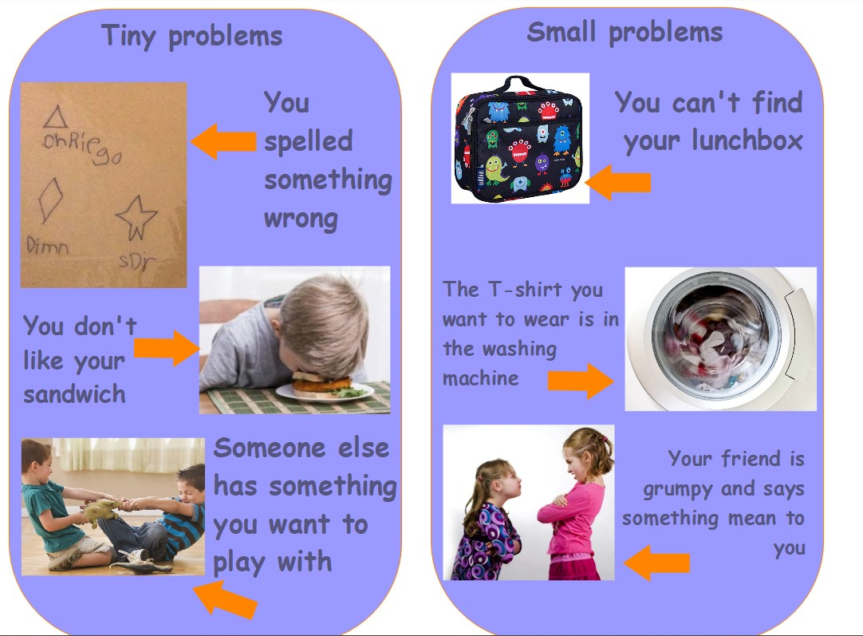
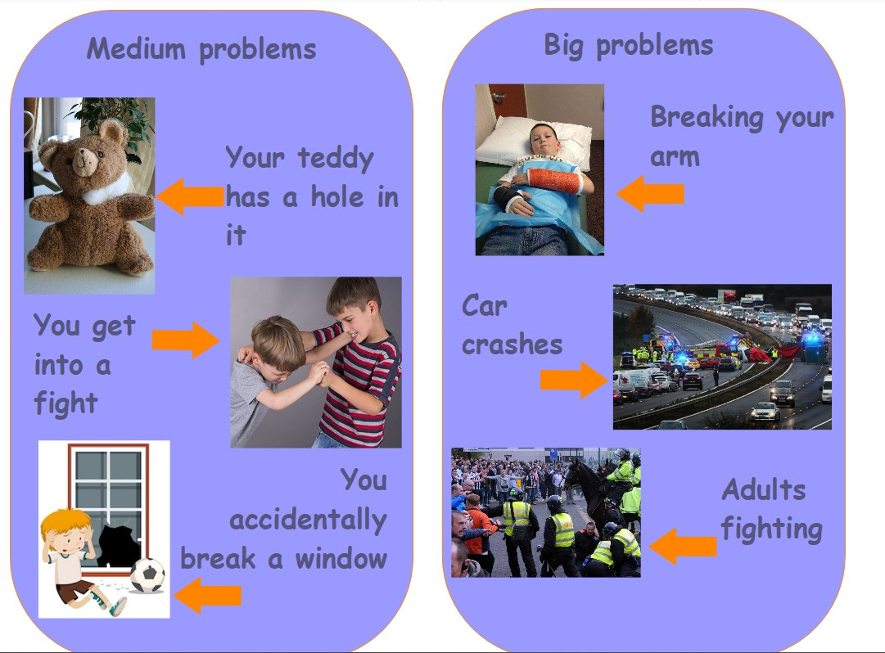
The Zones of regulation approach in Campsbourne School

Slide 25
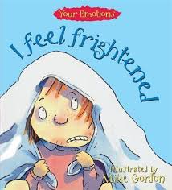
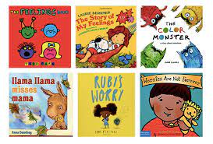
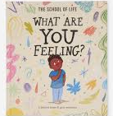
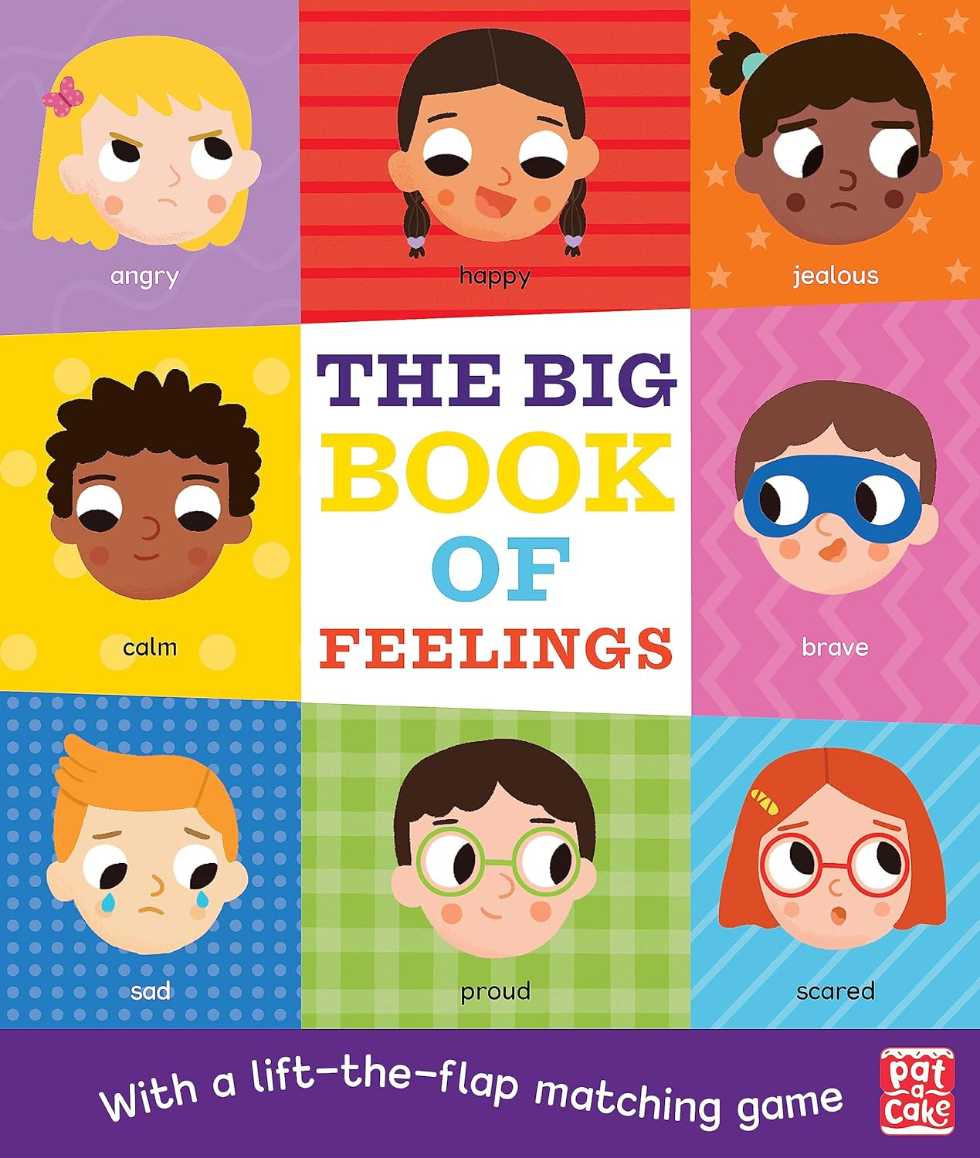
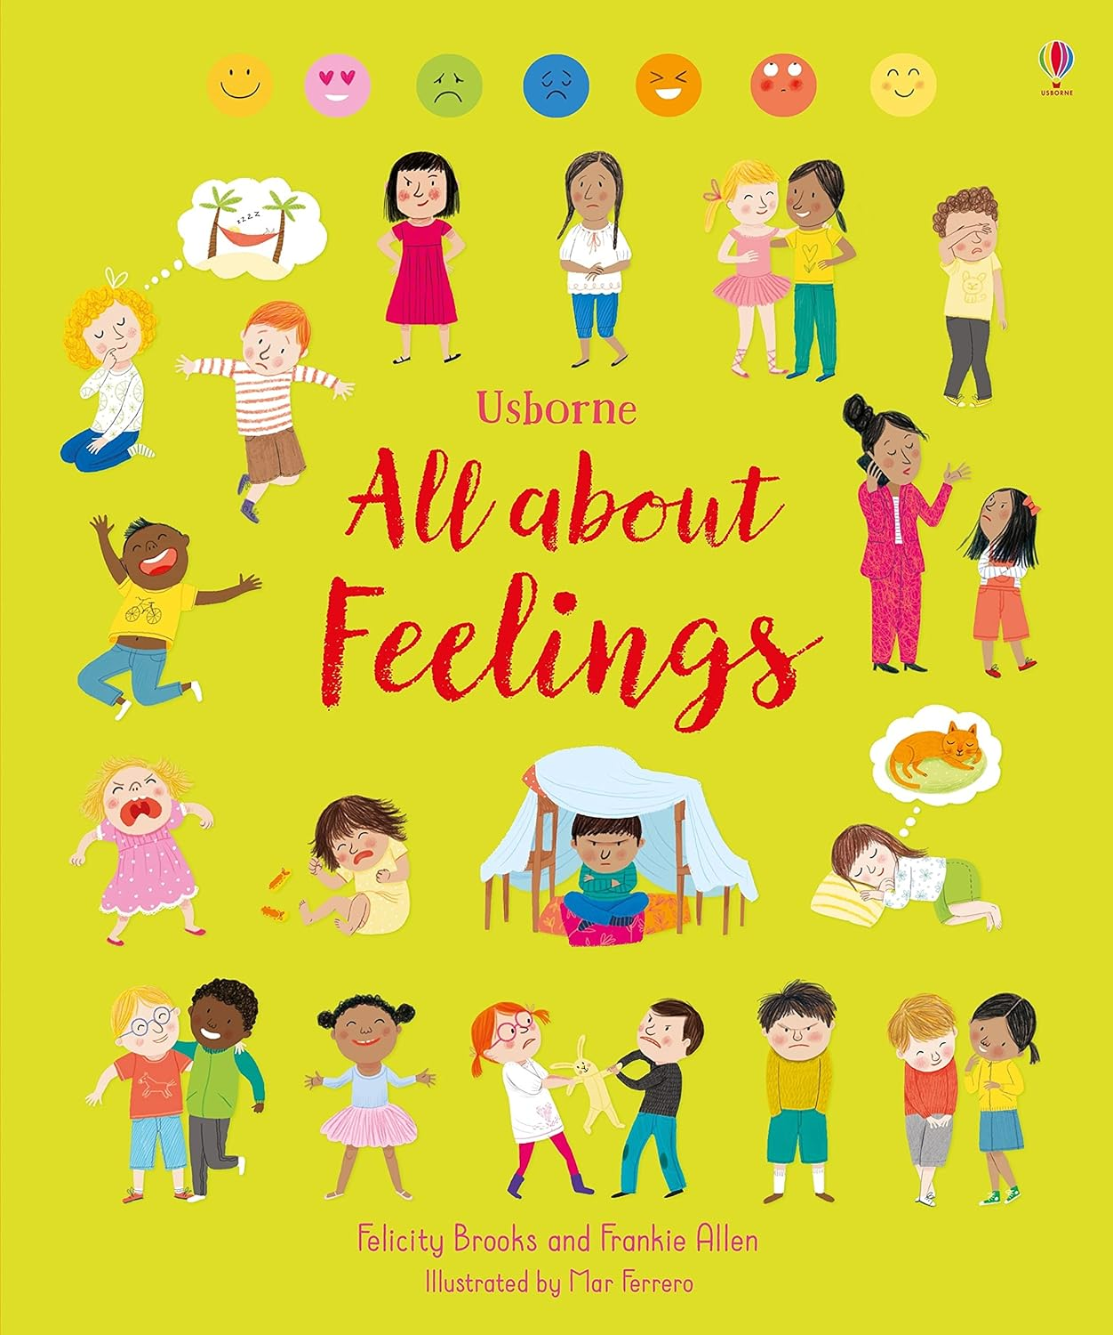
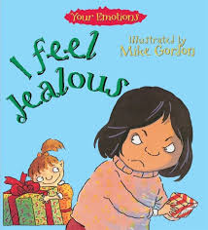

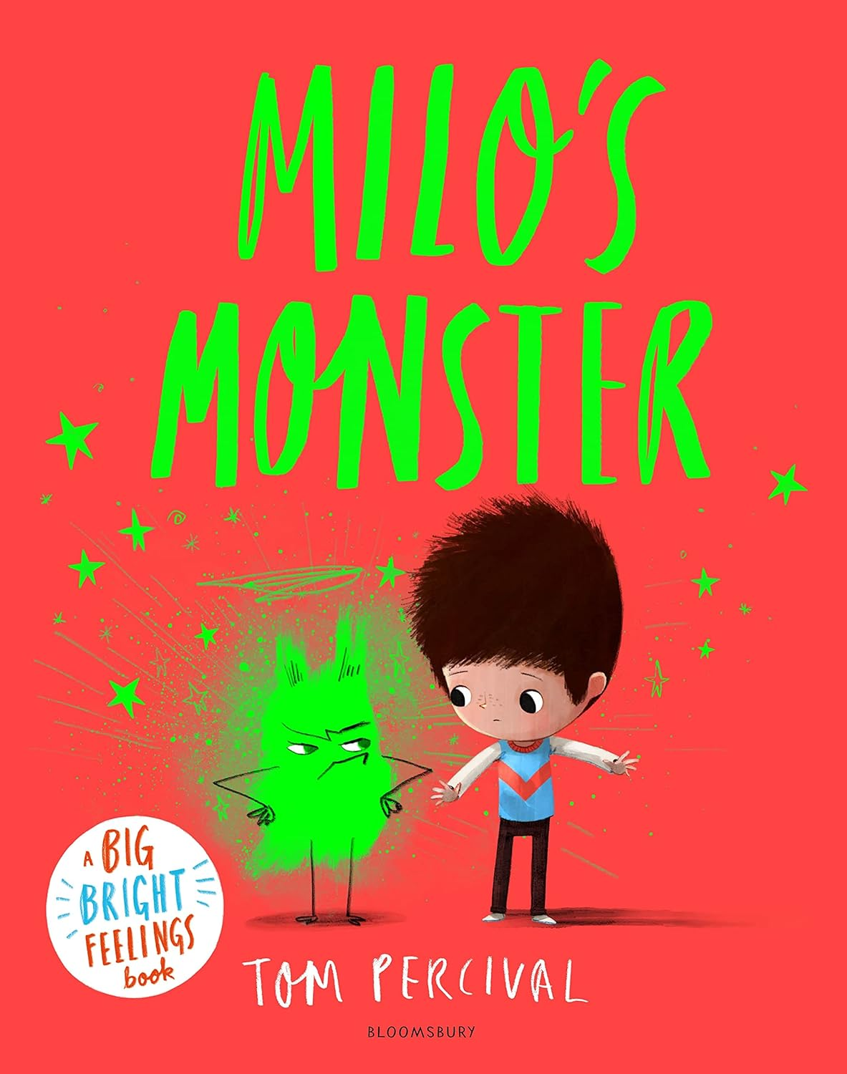
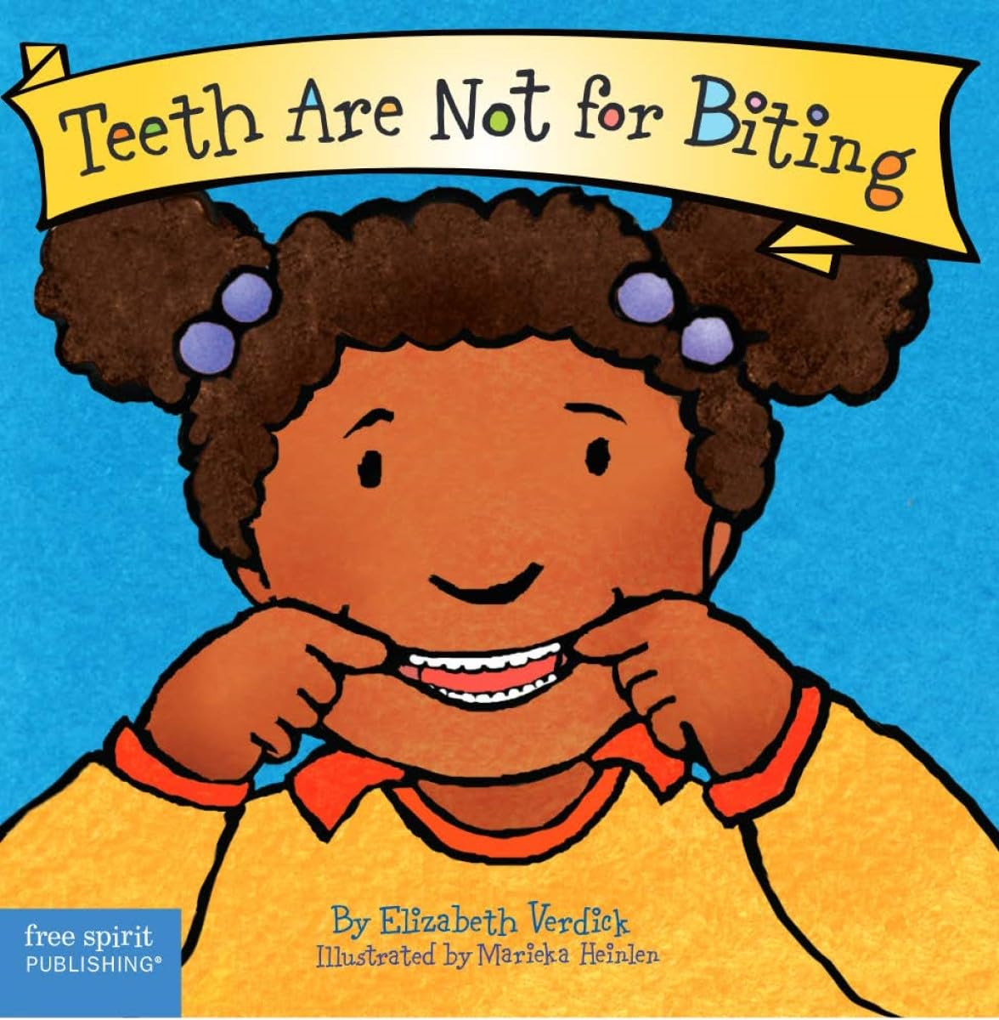
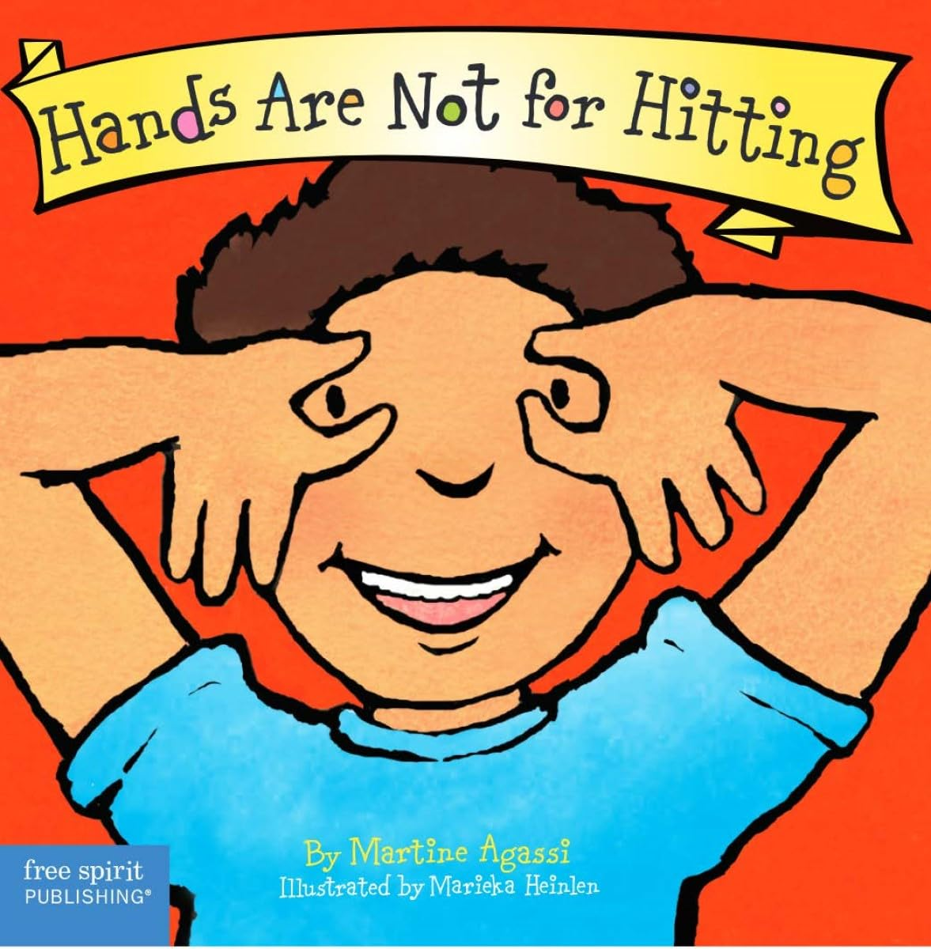
The Zones of regulation approach in Campsbourne School
Lesson 5
How our behaviour affects you and others:
General discussion on unexpected behaviour….
How did you feel at first? How did you feel as it continued? How do you feel now?

Slide 26

Questions

Slide 27
Resources and references
https://zonesofregulation.com/
Development matters
https://assets.publishing.service.gov.uk/media/64e6002a20ae890014f26cbc/DfE_Development_Matters_Report_Sep2023.pdf
Emotions
https://help-for-early-years-providers.education.gov.uk/personal-social-and-emotional-development/emotions#why-emotions-are-important
Sense of self
https://help-for-early-years-providers.education.gov.uk/personal-social-and-emotional-development/sense-of-self
Relationships
https://help-for-early-years-providers.education.gov.uk/personal-social-and-emotional-development/relationships

