Slide 1
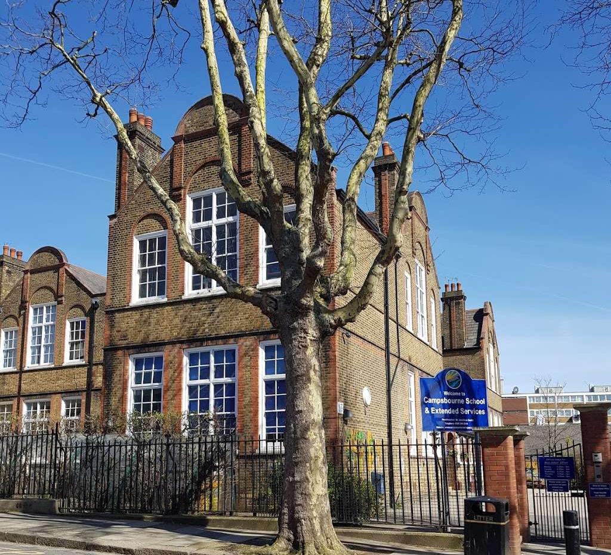

Welcome to Year 1
Meet the Teacher

Slide 2
Staff in Year 1
Class: 1 Riley
Tim Ershan
Class Name: 1 Ofili
Victoria Herringshaw

Slide 3
Start and Finish Times
The school day begins at 8.50am
Children line up when the bell rings – class teachers will bring the children into school
The school day finishes 3.25pm
Please collect your child from their classroom
If on occasions you arrange another parent / family friend / family member to collect your child, please make sure you let your class teacher know in the morning or call the office before 3:00pm. We will not be sending children home with adults if we have not been informed of home time arrangements.

Slide 4
What does my child need to bring to school?
Suitable clothing for each season
Book Bag (with a library book, reading diary and reading book once they have been given one).
1 Riley – Every Tuesday - 1 Ofili – Every Wednesday
Water bottle with their name on it

Slide 5

Swimming Kit
Swimming is every Tuesday for 1 Riley and every Wednesday for 1 Ofili.
The children will be in groups of 10 children.
They have been assessed – Group A starts next week!
KIT – Swimming costume or swimming trunks, a towel, a pair of goggles and a swimming hat.

Slide 6
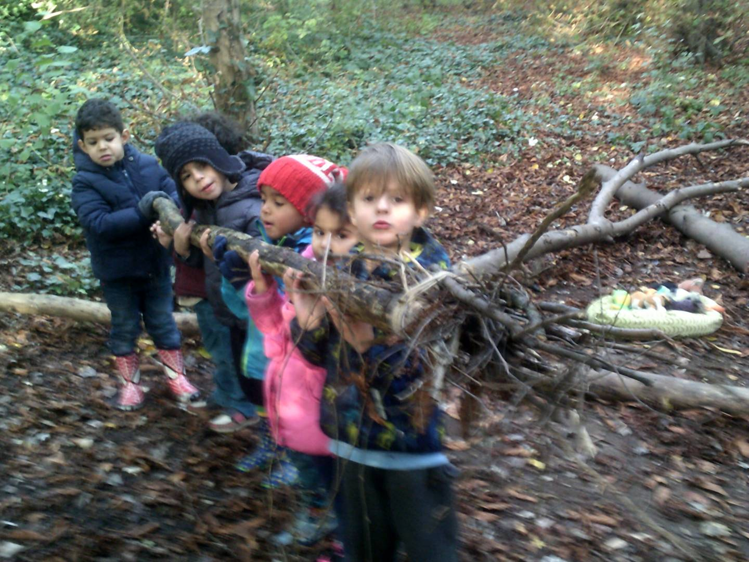
Forest School
Forest School now takes place for an entire term.
Year 1 – Autumn Term
Clothing
To allow the pupils to participate fully the correct clothing is essential for Forest School.
All children need to bring a change of clothes:
Wellingtons
Long trousers/ long sleeved top
Jumper/Sweatshirt
Waterproof coat and trousers
Hat, gloves and thick socks
Children who are in the AM session could they please come to school in their Forest School clothes.

Slide 7
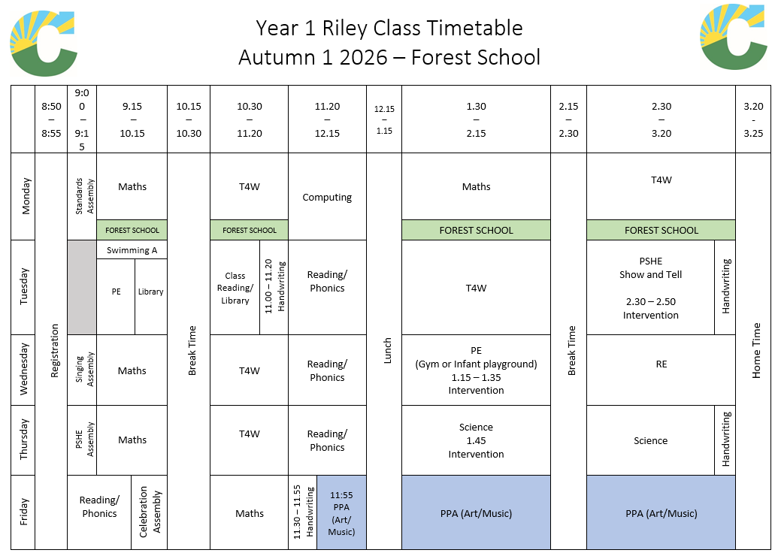
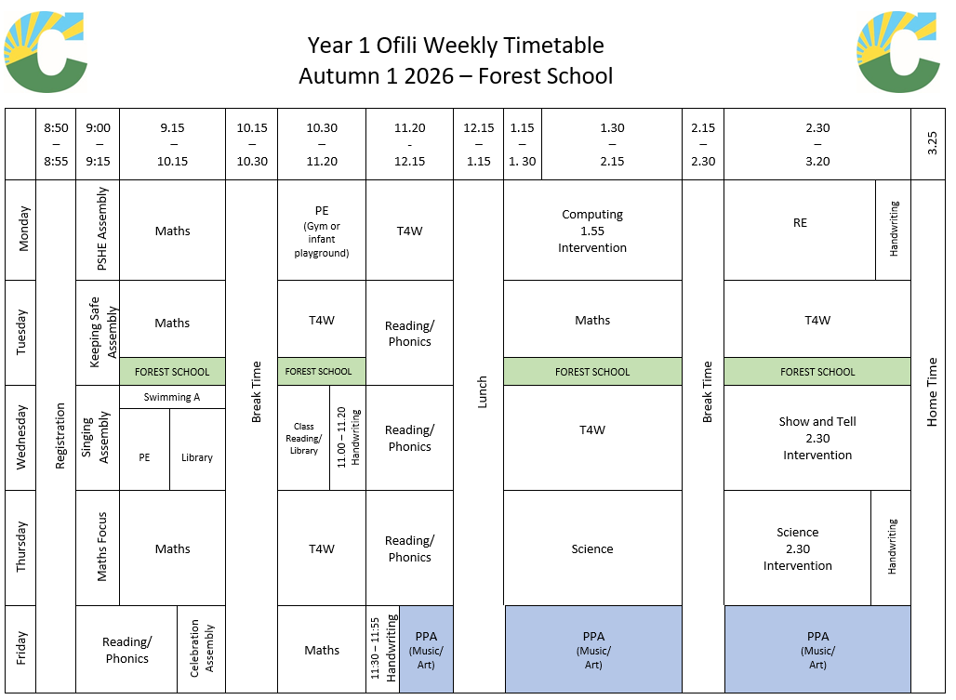
Class Timetables
Located outside each classroom

Slide 8

Across the school we teach literacy through our Talk for Writing program.
Enables children to imitate the key language they need for a particular topic orally before they try reading and analysing it.
Through fun activities that help them rehearse the tune of the language they need, followed by shared writing to show them how to craft their writing, children are helped to write in the same style.
You can find out more information at www.talk4writing.com/about

Slide 9

White Rose Maths is our program to deliver maths.
We teach the White Rose Maths program to the children. This approach to teaching maths ensures that children develop:
a deeper conceptual understanding over time through concrete and abstract learning opportunities
opportunities to apply mathematical concepts to a wide range of problem solving and reasoning problems.

Slide 10

Reading
Children grouped across the year 1.
Sounds Write Books are used each session – decodable and inline with the children’s phonic knowledge.
Key vocabulary focus – expanding children’s knowledge of words they may not come across everyday
Children read with a partner and independently across the week.
Daily comprehension sessions.
There is lots of reinforcement of key words because children are reading them everyday.
The books are enjoyable stories which encourage children to read for pleasure.
In this way children are reading daily, learning to enjoy books, building their confidence, increasing their reading mileage, developing comprehension and building on their bank of high frequency words.
I READ - Your child will bring home a decodable phonics book to share with you each week
YOU READ – Library Book

Slide 11
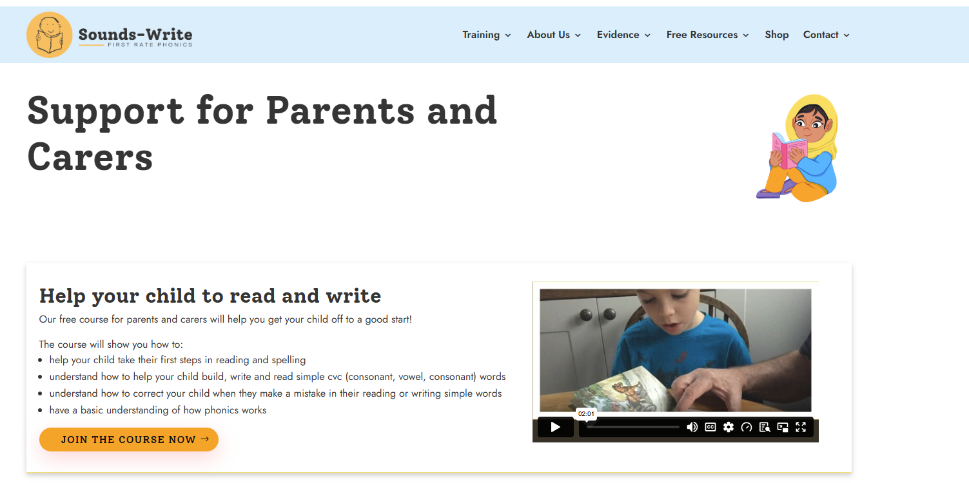

* Sounds-Write is a quality first phonics programme and is how we teach reading, spelling and writing.
* Children receive daily Sounds-Write lessons.
* Taught in Reception and KS1, then fine-tuned throughout the rest of Key Stage 2.
* In Reception and Year 1 the focus is very much on reading and spelling.
* In Year 2 to Year 6 the lessons focus on spelling.
* In addition, it also serves very successfully as an intervention or catch-up programme.

Slide 12

Wider Curriculum Overview
Autumn 1
Science: Human Body
History: Focusing on influential people who have made a difference
Personal, Social, Health and Economic (PSHE): Managing Safety and Risk – Forest School
Religious Education: Where do we belong?
Physical Education: Dance
Computing: Logging on/off – using a mouse/keyboard
Music: Found Sounds and Musical Pictures (with Jeannie)
Art: Learning about our Class Artists (with Siobhan)

Slide 13

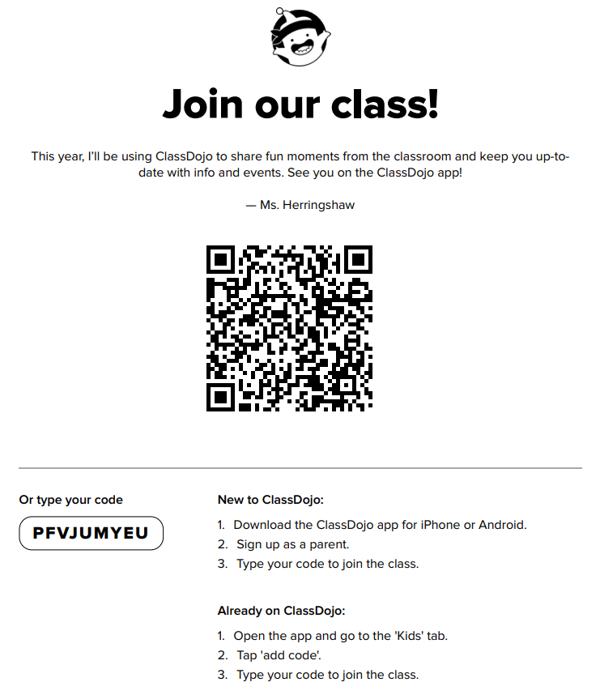
Join your Class using the QR code.
100 dojos = Bronze Certificate
200 dojos = Silver Certificate
300 dojos = Gold Certificate
Exceptional awards in the Summer term…
400 dojos = Diamond Certificate
500 dojos = Platinum Certificate

Slide 14
Assessment (Year 1 and Year 2)
Children in Year 1 and Year 2 will be teacher assessed in reading, writing and maths during lessons against the national curriculum objectives.
All Year 1 children are required to sit a national Phonics test in June 2027.

Slide 15
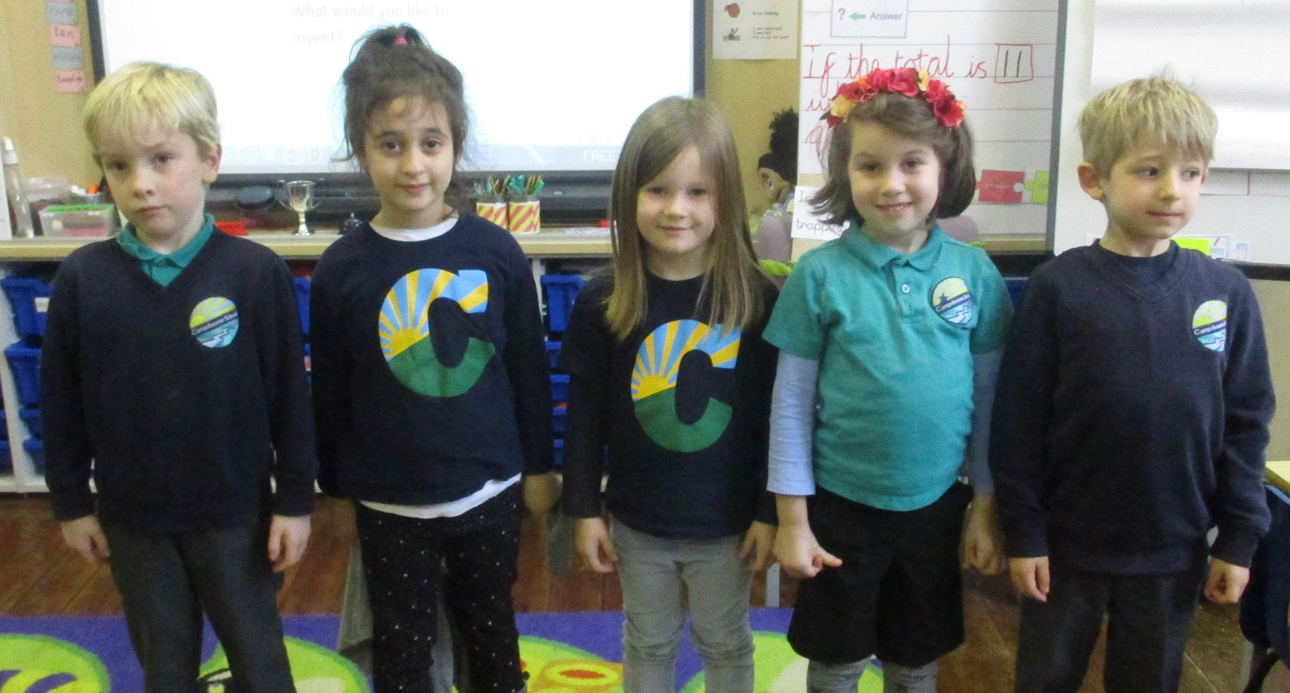
School Uniform
All children are expected to wear school uniform:
Campsbourne t-shirt, polo shirt, jumper or cardigan.
Sensible and comfortable shoes.
Please label all items of clothing!

Slide 16
Important Information
1 Ofili
Monday – PE
Tuesday - Forest Schools
Wednesday - Swimming and library, reading books changed
1 Riley
Monday – Forest School
Tuesday - Swimming and library, reading books changed
Wednesday - PE

Slide 17
Important Information
To help ensure consistency and fairness for all children, please do not send children into school with their own pens, pencils, fidgets, ear defenders or toys. These items are provided by school when needed, so that everyone has access to the same resources.
PARENTS OPEN MORNING – Autumn 1
Friday 9th October at 9am
PARENTS EVENING – Autumn 2
Tuesday 10th/Thursday 12th November
SEND Tuesday 24th/Thursday 26th November

Slide 18
Communicating with the teachers
Face to face - If you need to talk to your class teacher, please let them know at the beginning/ end of the day. If it is at the end of the day, please wait until all children have been dismissed.
By email – Please send an email to the school office
admin@campsbourne.haringey.sch.uk
We will endeavour to respond to your email within 5 working days.
If it is urgent please contact your class teacher as above.

Slide 19
Any Questions?

