Slide 1

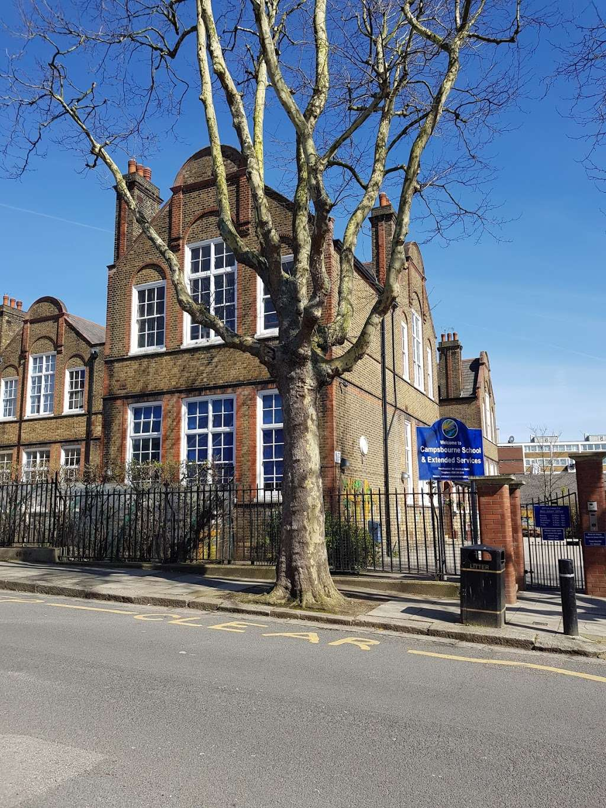
Welcome to Year 4
Meet the Teacher

Slide 2
Staff in Year 4
Kapoor
Zara
Whiteread
Daisy
Michelle
Rachel

Slide 3
What does my child need to bring to school?
Coat
Bag
Optional snack (needs to be healthy)
Water bottle with their name on it
Packed Lunch if they are packed lunch. Please refer to the food policy for guidance on items that should not be brought in. E.g. crisps/chocolate/nuts.
To help ensure consistency and fairness for all children, please do not send children into school with their own pens, pencils, fidgets, ear defenders or toys. These items are provided by school when needed, so that everyone has access to the same resources.
Please speak to SLT if you think your child requires a fidget or ear defenders.

Slide 4

In years 3 to 6, we teach the White Rose maths program to the children. This approach to teaching maths ensures that children develop a deeper conceptual understanding over time. This is done through concrete and abstract learning opportunities whilst also having the opportunity to apply mathematical concepts to a wide range of problem solving and reasoning problems.
We also do a weekly arithmetic test and their weekly times tables challenges.

Slide 5

Across the school we teach literacy through our Talk for Writing program.
Enables children to use the key language they need for a particular topic orally before they analyse it.
Followed by shared writing to show them how to craft their writing to the text focus (e.g. suspense writing)
You can find out more information at www.talk4writing.com/about

Slide 6
Destination Reader is the KS2 program to teach reading.
Destination Reader focuses on various strategies that help children to become more fluent in their reading and helps develop a love of reading.
Mondays and Tuesdays: Paired reading of a class text.
Thursdays: Answering a reading comprehension about either the class text, literacy text or current affairs.
Fridays: Independent reading a text of their own level independently.

Slide 7

Sounds-Write is a quality first phonics programme and is how we teach reading and spelling.
Children receive Sounds-Write lessons four times a week focusing on spelling.
It will also be used as an intervention or catch-up programme for children who may require it.

Slide 8
P.E
Kapoor
Tuesday – Gymnastics
Friday – Netball
Whiteread
Tuesday – Gymnastics
Friday – Swimming
Children should wear their PE kit to school on their PE days. This would mean children could wear leggings/tracksuit bottoms or shorts and trainers on the days that they have PE. They must wear their Campsbourne top to school, as following the school uniform policy, but can bring a t-shirt to change into for their PE session. This does not have to be a Campsbourne top but they must change back into their Campsbourne top after their PE session. Strictly no Football kits or tops are allowed. Gymnastics and dance should be done in bare feet for health and safety reasons; both classes are focusing on gymnastics this half term! In the cases that children have a verruca or similar, children can wear plimsols for their dance and gymnastics sessions, please speak to the class teacher. Jewellery and dangly earrings should not be worn for PE and should be removed. Stud earrings are fine. This is in line with our health and safety policy.

Slide 9

Wider Curriculum
The children will receive a rich curriculum consisting of History, Geography, PSHE, Science, RE, PE, Art, Music, Computing, Food Education, Design and Technology and Spanish.
We will be teaching these subjects mainly in the afternoons, where we will focus on developing the children’s independence and teamwork.

Slide 10
RE:
We are exploring and comparing most religions annually whilst focusing on a key question, e.g. What does it mean to belong to a religion?
History:
Romans
Ancient Greece
PSHE:
Diversity & Communities
Healthy & Safer Lifestyles
Managing Change
RSE (Human life cycle)- a separate letter will be sent home in June 2027.
Design & Technology:
Linkages and Levers
Electricity
Taste Education
Computing:
The Internet
Data logging
Photo editing
Repetition in games
Repetition in shapes
Audio production
Science:
Living things
Electricity
States of matter
Sounds
Animals including humans
Geography:
Rainforest
Water cycles

Slide 11
Changes to the Weekly Timetable
The children will have music and art lessons on a Wednesday afternoon taught by Jeannie and Siobhan.
Each class will have either art or music and then swap the following week.

Slide 12
Accelerated Reader
Accelerated reader is used in KS2 to promote reading at home and within school
MOST books within school have an AR code on them
Please note: Not all books are on the Accelerated reader system, so your child cannot take a quiz on all books they read.
Children will have the opportunity to complete Accelerated reader quizzes at school.

Slide 13
Assessment (Years 3 to 6)
Children are assessed daily in lessons through observations, marking and class discussions.
Children complete times tables challenges and arithmetic papers in class during Friday maths lessons.
Formal assessments will take place three times a year at the end of each term.
Times tables

Slide 14
Multiplication tables check
Schools must administer the multiplication tables check within the 2-week period in Summer term in June.
The MTC is a statutory, online assessment taken by all Year 4 pupils.
Pupils answer 25 random multiplication questions from 2×2 to 12×12.
Children have six seconds to answer each question.
Results help teachers identify which pupils are fluent and which may need additional support.
Please ensure your child is using their Times Tables Rockstars account throughout the week to ensure they are practising through games.
We will be monitoring this and guiding the children to ensure they are focusing on the right games/challenges.

Slide 15
Weekly challenges
Friday – Spelling challenge (on weekly homework letter for the following week) green is a Year 4 focus.
Times tables challenge on Fridays too!
3a=blue
6a=bronze
9= silver
12=gold

Slide 16

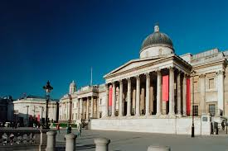
Educational Visits / Trips and Performances
We are hoping to have lots of fun trips this year!
Science Museum, British Museum and a few workshops ☺

Slide 17
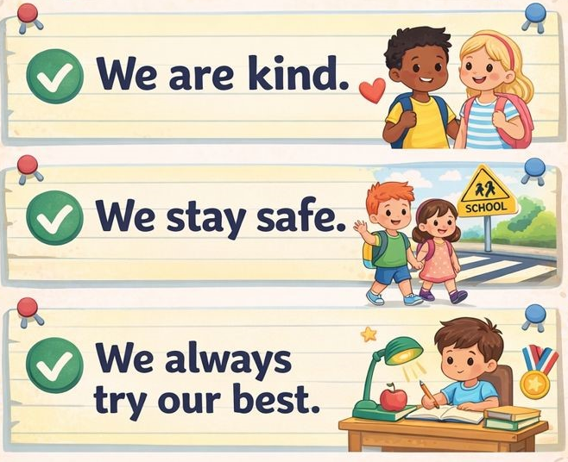
Behaviour
The school follows the Anchor Approach towards behaviour.
Children will have a restorative conversation if they are not following the school rules that are in place to keep everyone safe.

Slide 18
Pick Up
If on occasions you arrange another parent / family friend / family member to collect your child, please make sure you let the office know as early as possible.
We will not be sending children home with adults other than you, if we don’t receive a clear message from office staff.

Slide 19
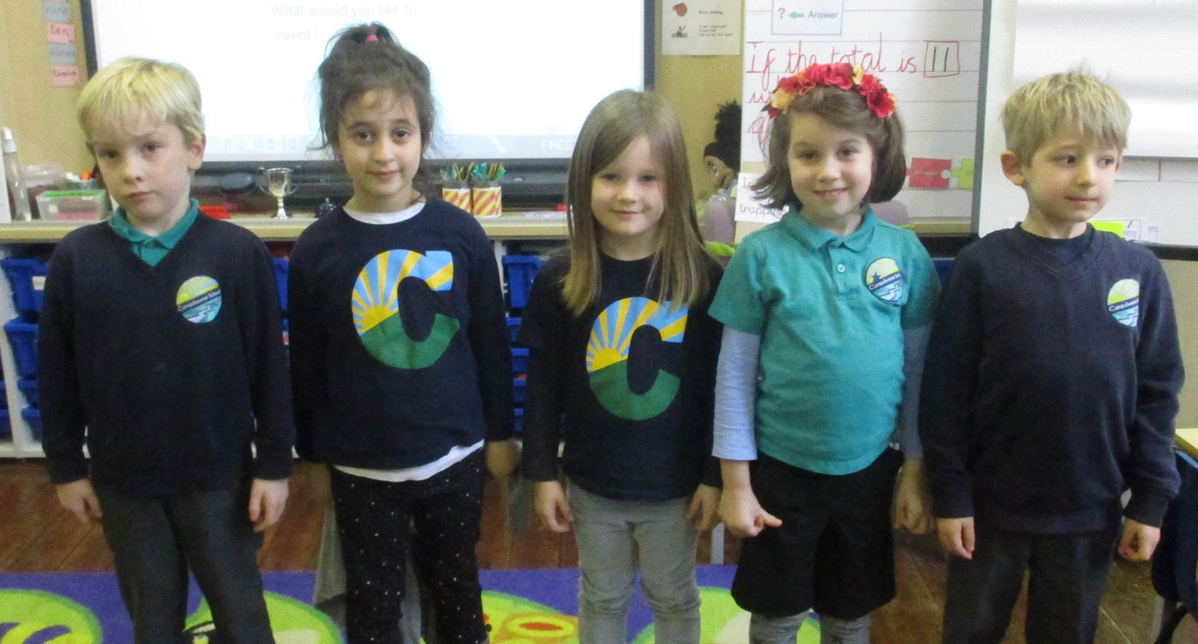
School Uniform
All children are expected to wear school uniform:
Campsbourne t-shirt, polo shirt, jumper or cardigan.
Sensible and comfortable shoes.
Please label all items of clothing!

Slide 20
Q&A

