Slide 1

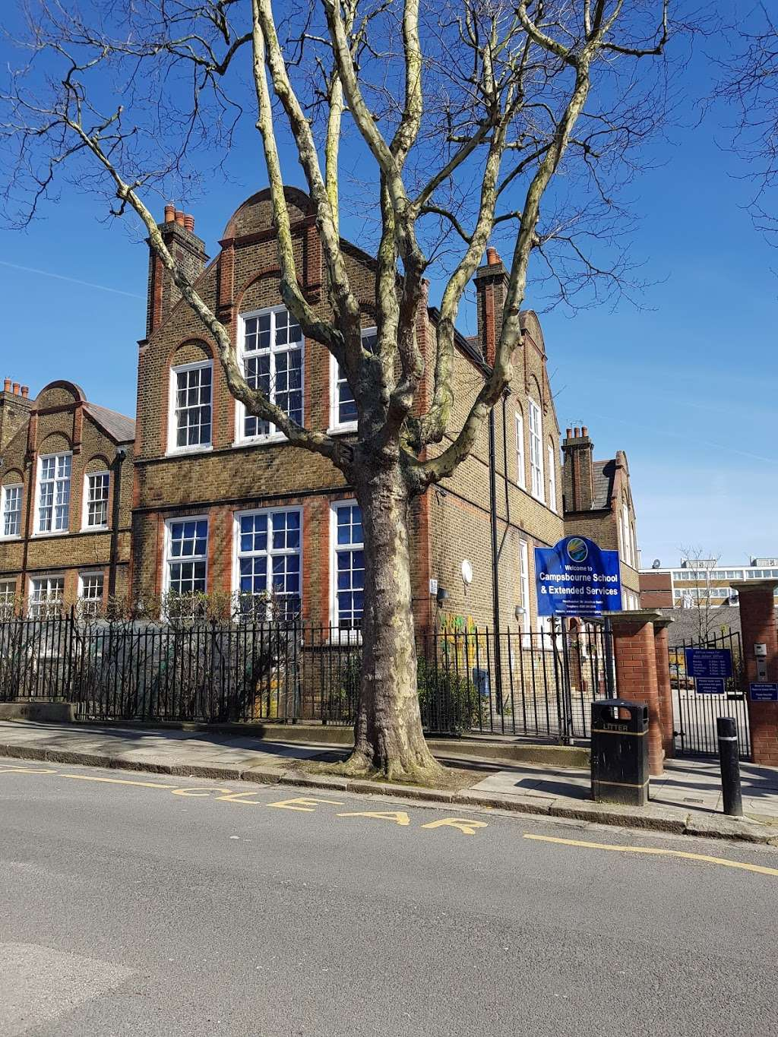
Welcome to Year 6
Meet the Teacher

Slide 2
Staff in Year 6
Joshua – Himid teacher
Louisa – Shonibare teacher
Josh 1-to-1 – morning
Amber 1-to-1 – afternoon
Please find below the email address of the school that you may need to use if you need to get in touch with either of us during Year 6:
admin@campsbourne.haringey.sch.uk

Slide 3
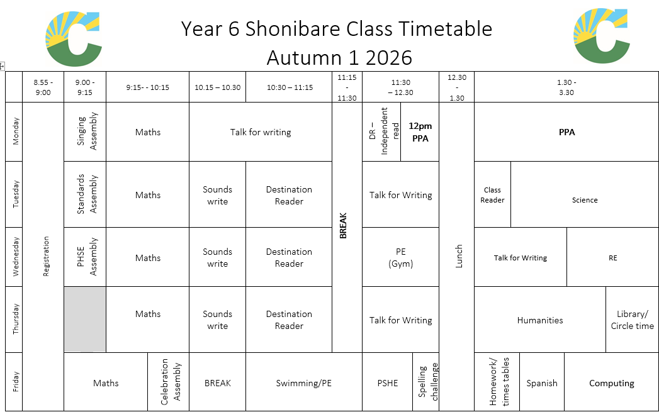
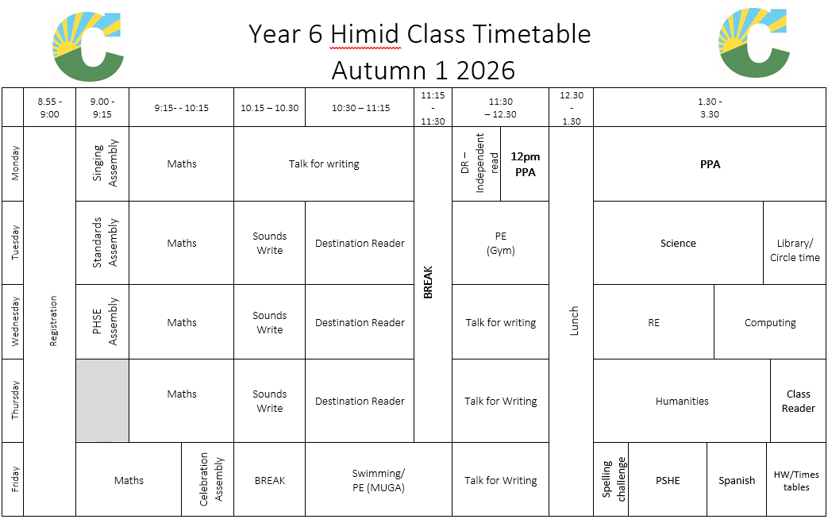
Daily Routines
Assembly
Maths
Sounds Write
Destination reader
Break – 11:15 till 11:30
Literacy
Lunch
Afternoon lessons
On Friday break will remain at 10:15 following celebration assembly

Slide 4

Literacy
Across the school we teach literacy through our
Talk for Writing program.
Enables children to imitate the key language they need for a particular topic orally before they try reading and analysing it.
Through fun activities that help them rehearse the tune of the language they need, followed by shared writing to show them how to craft their writing, children are helped to write in the same style.

Slide 5

In year 6, we teach the White Rose maths program to the children. This approach to teaching maths ensures that children develop a deeper conceptual understanding over time through concrete and abstract learning opportunities.

Slide 6
Destination Reader
Destination Reader (DR) is our KS2 program to teach reading.
Promotes a love for reading
Opportunities to share and discuss texts throughout the lesson
Provides children with the necessary skills to become confident and competent readers
Develop children’s ability to listen and respond to other’s opinions about a text.

Slide 7
Accelerated Reader
Accelerated reader is used in KS2 to promote reading at home and within school
MOST books within school have a code on them
Children can use this code to complete a quiz on Accelerated Reader at school
If your child achieves 80% or more, they will earn a certificate.
Please note: Not all books are on the Accelerated reader system, so your child can not be tested on all books they read.
Children will have the opportunity to complete Accelerated reader quizzes using a class tablet.

Slide 8

Spelling
In Years 1- 6 we use the ‘Sounds Write’ program to teach the children spelling rules and conventions. The children have a 15 minute session three times a week where they are focusing on a key spelling rules.
Please support the children at home by practising their spellings daily.
Spellings are sent home every Friday
Spelling Challenge takes place on the following Friday.

Slide 9

Wider Curriculum
Science (Animals including humans)
Humanities – The Vikings, Geography: The Biosphere and Migration to Britain - a local study.
Personal, Social, Health and Economic (PSHE) (Rules, Responsibilities & Rights)
Religious Education (all religions with a focus on influencing)
Physical Education (Athletics, games, dance and gymnastics)
Music (Exploring the Blues)
Art (exploring our classes artist)
Design and Technology
Computing
Spanish

Slide 10
Physical Education
Himid: Tuesday and Friday
Shonibare: Wednesday and Friday
Please make sure your child has a t-shirt, shorts/jogging bottoms and a suitable change of shoes each week.
Your child can bring in an extra t-shirt on the day of PE if they wish to do so.
Children can wear these items to school on these days to make it easier, rather than changing at school.
Swimming: Fridays!
In year 6, there will be a small group of children who have not yet met the swim based end of primary age swimming expectations.

Slide 11
Assessment (Years 3 to 6)
Children in Year 3 to Year 6 will be teacher assessed in reading, writing and maths during lessons, against the previous years objectives.
This will enable us to identify any gaps in knowledge which we need to teach.
Children will then sit written assessments against the autumn term objectives for their current year group at the end of the autumn term.

Slide 12
SATs
Year 6 SATS usually takes place in May. The children will take tests for Reading Comprehension, Grammar and spelling and Maths.
Writing is assessed by the teacher across the year.
The assessments will happen W/C Monday 10th May.

Slide 13
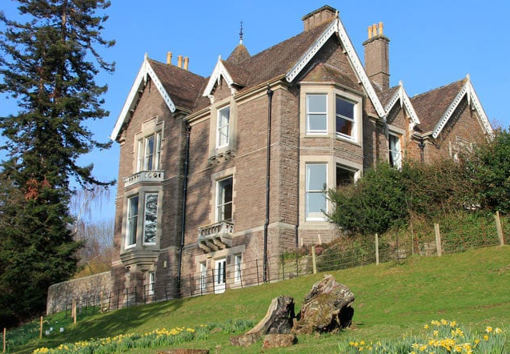
Trips and events
Variety of workshops for PSHE e.g. POW workshops (healthy relationships) and Junior Citizens
Museum
Viking Day
Christmas Show
Pendarren – 8th – 12th March
End of Year trip
Cinema trip
Year 6 End of Year Performance

Slide 14
Behaviour
The school has adopted the Anchor Approach towards behaviour.
Children will receive reflection time if they are not following the school rules that are in place to keep everyone safe followed by a discussion with a trusted adult.
Classes are receiving marbles for whole class achievement.
50 marbles = 30 minutes reward time
Stars are awarded for lining up sensibly and if exceptional behaviour is noted by another teacher. 10 stars result in extra playtime.
We will continue to also use class dojo with children receiving certificates when they meet certain milestones e.g. 100 dojos equals Bronze etc…

Slide 15
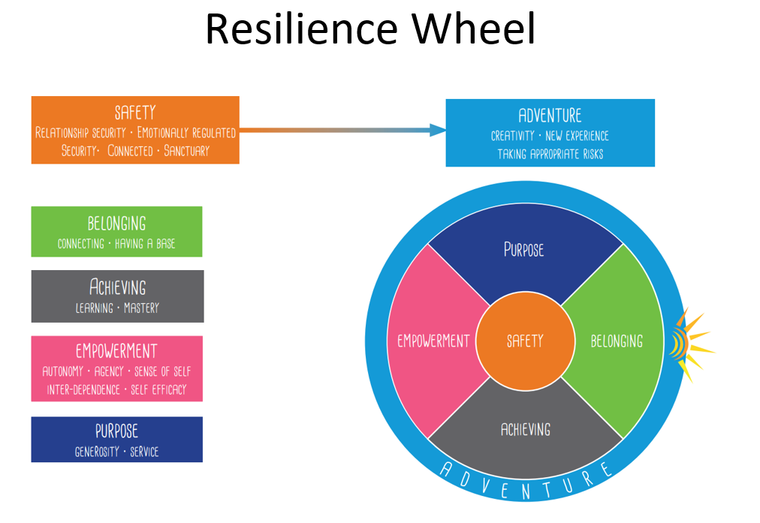
Behaviour
Weekly certificates received in assembly will now be linked to the resilience wheel’s key ingredients.
We will have a particular focus on recognising impressive learning behaviours that the children display in class and throughout the school.

Slide 16
Pick Up
Some children in Years 5 and 6 are ‘Home alone’ which means that they have been given written/signed permission by parents to make their own way home after school. Please make sure that you have updated your ‘Home alone’ letter request.
If on occasions you arrange another parent / family friend / family member to collect your child, please make sure you let the office know before 3:15pm. We will not be sending children home with adults other than you, if we don’t get a clear message from office staff.

Slide 17
What does my child need to bring?
Coat
Book Bag with a book once they have been given one
PE / Swimming Kit on the day they need it. Please ensure your child does not wear a football shirt.
Autumn 1 –
Himid: PE (Gym) Tuesday and PE (MUGA) Fridays.
Shonibare: PE (Gym) Wednesday and PE (MUGA) Fridays.
For the children in the swimming group, they will need their swimming kit on Friday, including a swimming hat.
Water bottle with their name on it

Slide 18
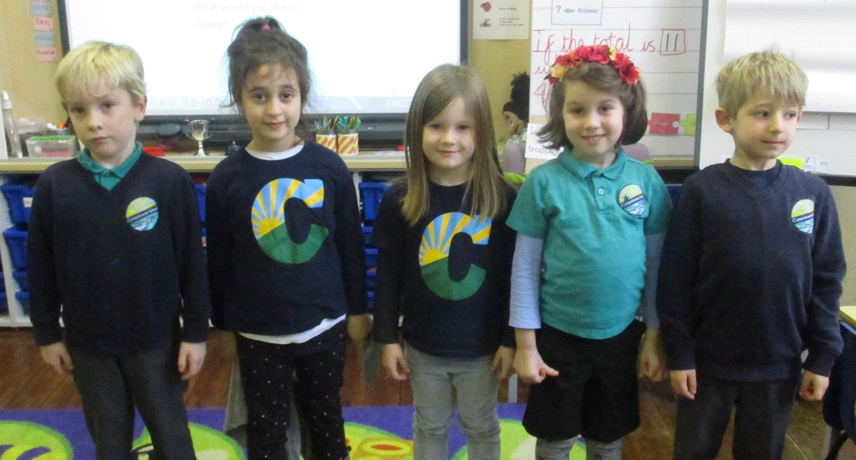
School Uniform
All children are expected to wear school uniform:
Campsbourne t-shirt, polo shirt, jumper or cardigan.
Sensible and comfortable shoes.
Please label all items of clothing!

Slide 19
Home support
Homework – This will be given to children every Friday (one maths, one grammar or reading sheet and spellings) and is expected to be given back to the teacher by Wednesday of the following week.
Reading (hearing and reading to)
Times tables & spelling
Real life experience: e.g. shopping and cooking ( time , money, measurements, etc.)
Log in details for TTRS have been sent home
AR will be sent home soon but the log-in details are the same.

Slide 20
Resources
To help ensure consistency and fairness we ask that children do not bring any resources into school
We will provide children with their own pens, pencils, rulers.
We will also provide children with fidgets and ear defenders when it is needed.
The school provides these resources so everyone has access to the same.
We ask you to make sure children are not bringing in their own resources.

Slide 21


