Slide 1
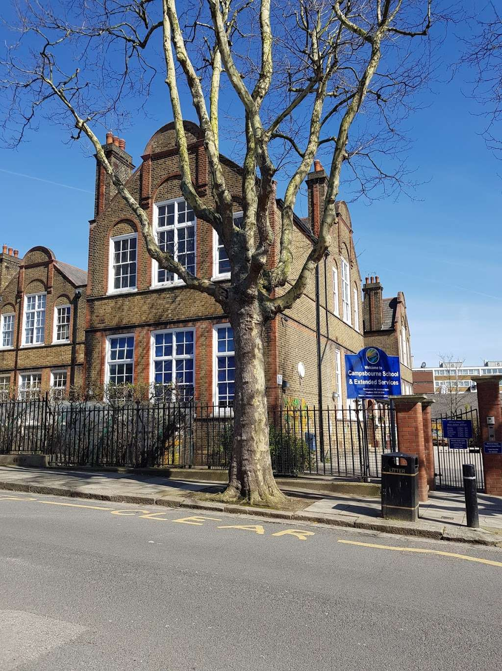
What we will cover today:
Staff in Year 2
What your child will need
School uniform
Routines (a typical day)
Overview of core subjects
Assessment
Wider curriculum
Trips
PE / Swimming
Behaviour and ClassDojo
Drop off/Pick up
Communicating with the teachers
Support at home

Slide 2
Staff in Year 2
2 Moore:
Lucy Norman
Luiza
Rose
2 Hepworth:
Alix Baker

Slide 3
What does my child need to bring?
Coat/raincoat
Book Bag
PE / Swimming Kit on the day they need it.
Water bottle (with their name on it)
Packed lunch if required
Fruit snack
Book from home
Please label EVERYTHING!
To help ensure consistency and fairness for all children, please do not send children into school with their own pens, pencils, fidgets, ear defenders or toys. These items are provided by school when needed, so that everyone has access to the same resources.

Slide 4
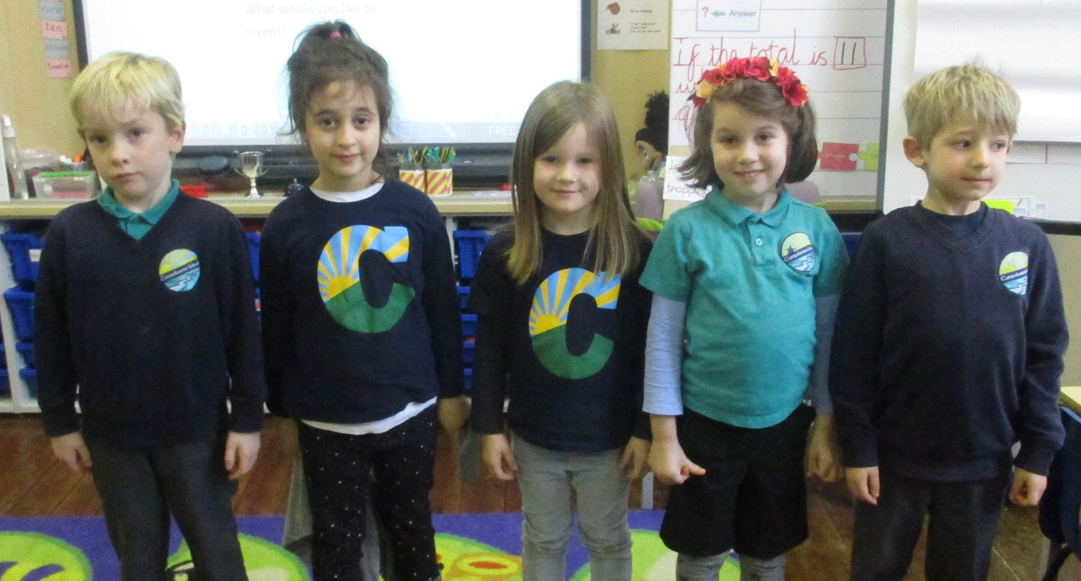
School Uniform
All children are expected to wear school uniform:
Campsbourne t-shirt, polo shirt, jumper or cardigan.
Sensible and comfortable shoes (that they can fasten themselves!).
Please label all items of clothing!

Slide 5
PE Uniform
Children should wear their PE kit to school on their PE days:
    Leggings/tracksuit bottoms or shorts and trainers.
    White top
    Strictly no Football kits or tops are allowed.
    Gymnastics and dance should be done in bare feet for health and safety reasons. In the cases that children have a verruca or similar, children can wear plimsols for their dance and gymnastics sessions.
    Jewellery and dangly earrings should not be worn for PE and should be removed. Stud earrings are fine. This is in line with health and safety.

Slide 6
Routines (a typical day)
Registration
Assembly
Maths
Break – ( a fruit snack)
Sounds Write
Guided Reading/Phonics reading groups
Literacy (Talk 4 Writing)
Lunch
Foundation subjects
Afternoon play
Foundation subjects
Other staff
Music – Jeannie
Art – Siobhan
On a Wednesday we will not be present at morning drop-off.
Swimming Teacher - Jack

Slide 7
Class timetables
We will send these to you via email.

Slide 8

At Campsbourne, we teach the White Rose maths program to the children.
Children develop a deeper understanding over time through concrete and abstract learning opportunities whilst applying mathematical concepts to a wide range of reasoning problems.

Slide 9

Sounds Write
Sounds-Write is how we teach reading, spelling and writing.
Children receive daily Sounds-Write lessons.
In Year 2 to Year 6 the lessons focus on spelling.
We focus on building words using the different sounds before moving onto polysyllabic words.

Slide 10
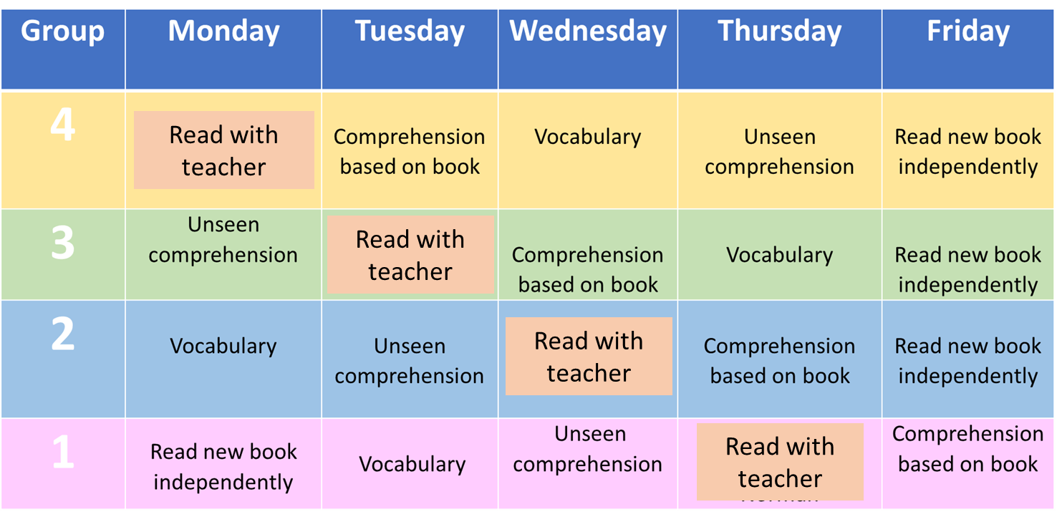
Guided Reading
Children’s guided reading books are changed every Friday, you will also receive a book to write in.
2 Moore visit the library every other Tuesday
2 Hepworth visit the library every other Thursday
The focus of reading in year 2 is on comprehension as well as fluency. Please do not be alarmed if your child has already read the text they bring home.
N.B. Phonics based reading groups for those children who need a little more practise.

Slide 11

Across the school we teach literacy through our Talk for Writing program.
Enables children to imitate the key language they need for a particular topic orally before they try reading and analysing it.
We imitate, innovate and invent a text.
You can find out more information at www.talk4writing.com/about

Slide 12
Assessment (Year 2)
On-going
Weekly spelling challenges
End of Autumn and Summer assessments

Slide 13

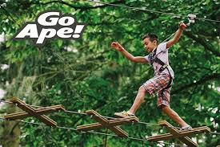
Educational Visits / Trips and Performances
1st December 12:30: Cinderella on Ice at Alexandra Palace
Dates TBC:
Autumn term: Alexandra Palace/Park
Spring term: Science Museum
Summer term: Go Ape

Slide 14
Physical Education
Swimming: Swaps every half term between group A and B
Hepworth – Thursday
Moore - Friday
PE:
Moore – Wednesday for all (gym)
Friday (for those who are not swimming, outside)
Hepworth – Monday for all (gym)
Thursday (for those who are not swimming , outside)

Slide 15
Behaviour
Golden stars – can be collected by the whole class for lining up at the end of playtimes or lunchtime.
50 marbles in a jar – classes can collect 50 marbles in a jar for following the golden rules and independent work.
Dojo Points – are awarded to individual/groups/whole class for showing excellent behaviour and completing great work. Every 100 dojos, your child will get a certificate.
Anchor approach - We are using the anchor approach as our behaviour policy. E.g. positive relationships, proximity, calm corner

Slide 16
Drop off/ Pick Up
Start at 8.55am and finish at 3.30pm.
Please make sure your child has told us they are leaving the line at the end of the day.
If on occasion, you arrange another parent / family friend / family member to collect your child, please make sure you let the office know before 3pm. We will not be sending children home with adults other than you if we don’t get a clear message from office staff.

Slide 17
Communicating with the teachers
If you need to talk to your class teacher, please let them know at the beginning/end of the day.
N.B. We will not be using the Dojo app or direct emails for contact between us.
If you need to contact the school, please email admin@campsbourne.haringey.sch.uk The office will make sure your message reaches the correct person quickly.

Slide 18
Communicating with the teachers
If you have day-to-day queries (lost property, info on trips, questions about medicine or first aid) please call or email the front office on: 020 8340 2064
You can email Diane on: admin@campsbourne.haringey.sch.uk or diane.sewell@campsbourne.haringey.sch.uk and you can also email Pawandeep at the front office on: pawandeep.kaurbains@campsbourne.haringey.sch.uk
For almost all issues we ask you to talk to your child’s teacher first and then if you are not happy with the outcome please ask one of the Senior Leadership Team. The Senior Leadership Team are me (Lucy), Morgan, Tracey and Jason.
I am generally at Campsbourne on a Monday and Tuesday, the Wednesdays switch and then on Thursdays and Fridays I am at Stroud Green. The rest of the SLT are full time Monday - Friday.
Lucy Walker-Collins (Executive Head Teacher): lucy.walker-collins@campsbourne.sch.uk
Morgan is Head of School, Pastoral Lead and Designated Safeguarding Lead: Morgan.Currie@campsbourne.haringey.sch.uk
Tracey is Assistant Headteacher for Assessment and Curriculum: tracey.john- baptiste@campsbourne.haringey.sch.uk
Jason is Assistant Headteacher for SEND and EYFS: Jason.Steel@campsbourne.haringey.sch.uk

Slide 19

Home support
Homework (home-learning letters on a Friday)
Spellings
Quick maths/recall of number facts (WRM app, Hit the Button)
Reading (listening to and reading to)
Talking and playing games (cards, chess, board games).
Real life experience: e.g. shopping and cooking.

Slide 20
Dates for your diary:
Parents evening: 10th and 12th November
SEND parents evening: 24th and 26th November
End of term (finish at 13:45): 18th December

Slide 21
Questions?

