Slide 1

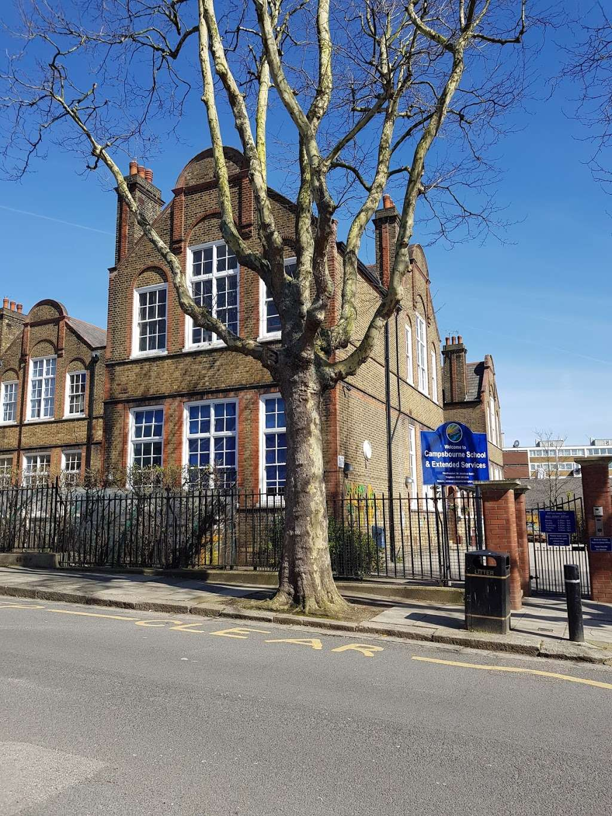
Welcome to Year 3

Slide 2
Staff in Year 3
3 Hockney
Jenny Vincent
Cathie
Vera
3 Cameron
Rosa Phelps
PPA cover – Jeannie and Siobhan
Music and Art on Friday mornings (they will collect from the playground)
Regular cover – Tracey and Steve
Rosa – Every Thursday afternoon (Tracey cover Cameron)
Jenny – Some Wednesday mornings (Steve cover Hockney)

Slide 3
What does my child need to bring?
Coat / raincoat
Book bag
PE Kit:
  Tuesday and Thursday* (Hockney)
  Monday and Wednesday* (Cameron)
  Please send your child in on these days in appropriate PE clothes
Swimming kit:
Every *Thursday (Hockney Autumn 1, Cameron Autumn 2)
Water bottle with their name on it
Packed Lunch (if applicable)*
Fruit snack for break time*
*We are a nut free school!
Please label EVERYTHING!
To help ensure consistency and fairness for all children, please do not send children into school with their own pens, pencils, fidgets, ear defenders or toys. These items are provided by school when needed, so that everyone has access to the same resources.

Slide 4
Drop off and pick up:
Start at 8.55am and finish at 3.30pm.
Middle playground
All parents should remain behind the line/cones.
Children should not be using the play equipment and climbing frames before or after school.
Please bear with us when we are dismissing, whilst we get to know you all. We will get quicker!
If on occasion, you arrange for another parent / family friend / family member to collect your child, please make sure you let the office know before 3pm. We will not be sending children home with adults other than you if we don’t get a clear message from office staff.

Slide 5
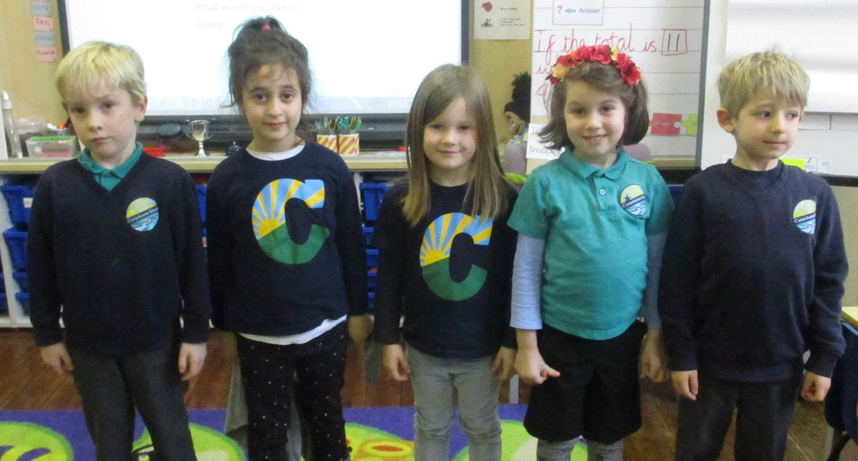
School Uniform
All children are expected to wear school uniform:
Campsbourne t-shirt, polo shirt, jumper or cardigan.
Sensible and comfortable shoes.
Please label all items of clothing!

Slide 6
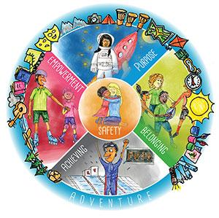

Behaviour:
The Anchor Approach
100 dojos = Bronze Certificate
200 dojos = Silver Certificate
300 dojos = Gold Certificate
400 dojos = Diamond Certificate
500 dojos = Platinum Certificate

Slide 7
Year 3 curriculum

Slide 8
Main differences in the KS2 timetable (compared to KS1):
Fruit snack from home
Breaktime is slightly later (11:15-11:30am)
Lunchtime is slightly later (12.30-1.30pm)
No formal afternoon play (however we will give the children movement and brain breaks)
Accelerated Reader*
Times Tables Quizzes*
Spanish*
Swimming*
Forest school (Spring term)*

Slide 9
Maths

Slide 10

Maths lessons:
White Rose Maths is our whole school program to teach maths.
We teach the White Rose Maths program to the children. This approach to teaching maths ensures that children develop:
a deeper conceptual understanding over time through concrete and abstract learning opportunities
opportunities to apply mathematical concepts to a wide range of problem solving and reasoning problems.

Slide 11

TT Rockstars:
Your child should have a login from Year 2. We sent our login details last week so please let us know if you need another copy. Please check your child is able to log in.
We will set times tables for your child to work on.
Please encourage your child to practise their times tables regularly.
In KS2, knowing times tables will help your child enormously with all of their learning in Maths.

Slide 12
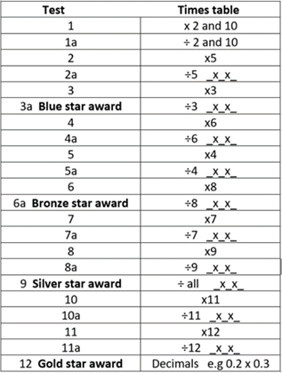
Times tables challenges:
Fridays
The table on the right shows what each challenge will test the children on, and where the badge milestones are.
Continued throughout Y3-Y6
Weekly
5 minutes for 30 questions

Slide 13
Reading

Slide 14
Destination Reader (DR)
Destination Reader is our KS2 program to teach reading.
DR focuses on various reading strategies that help children to become more fluent in their reading, and helps develop a love of reading.
There is a big focus on vocabulary and discussion.
The books are enjoyable texts which encourage children to read for pleasure.
Strategies
Clarifying
Summarising
Inferring
Making Connections
Predictions
Asking questions
Evaluating

Slide 15







Examples of our DR texts:

Slide 16
Accelerated Reader
Accelerated Reader is used in KS2 to promote reading mileage at home and within school
AR levels are based on comprehension (not fluency) level
MOST books within school have a code on them
Children can use this code to complete a quiz on Accelerated Reader
Please note: Not all books are on the Accelerated Reader system, so your child can not be tested on all books that they read at home.
Children will have the opportunity to let their class teacher know they are ready to complete an Accelerated Reader quiz (at school) using a class tablet (time permitting) or during designated slots in assembly times.

Slide 17
Writing

Slide 18

Across the school we teach literacy through our Talk for Writing program.
Enables children to imitate the key language they need for a particular topic orally before they try reading and analysing it.
Through fun activities that help them rehearse the tune of the language they need, followed by shared writing to show them how to craft their writing, children are helped to write in the same style.
You can find out more information at www.talk4writing.com/about
Genres covered in Year 3:
Fiction – Warning stories
Non-fiction – Discussion Texts
Fiction – Portal stories
Non-fiction – Information texts
Fiction – Defeat the Monster stories
Non-Fiction – Diary Entry (recount writing)

Slide 19

Sounds-Write is a quality first phonics programme and is how we teach reading, spelling and writing. Children receive daily 15 minute Sounds-Write lessons. In Year 2 to Year 6 the lessons focus on spelling.
Spelling challenge every Friday – based on spelling patterns previously taught at school (as well as common exception words)

Slide 20
Weekly challenges in KS2:
Spelling challenge - (Fridays) Spellings will be sent out on a Friday, (after we have explored them as a class that week)
Times Tables Challenge – (Fridays) The children progress through all the times tables at their own speed and earn badges)
Arithmetic – Friday maths lessons have an arithmetic focus. We will be working on the children's recall, fluency and use of appropriate and effective strategies (e.g. number lines, column method).

Slide 21
Assessment (Years 3 to 6)
We have three main assessments weeks in the school. These take place at the end of Autumn 2, Spring and in Summer 2.
During these assessment weeks, the children will complete assessment papers in Reading, Maths and SPAG (Spelling, Punctuation and Grammar).
Teachers use these to inform their teacher judgements.
These also help to inform us of gaps in the children’s knowledge so that we can plan for them effectively.
Writing is teacher assessed throughout the year.

Slide 22
The wider curriculum:
Science – Animals including human; Rocks, fossils and soils; Light; Plants; Forces and Magnets
History - Stone Age to the Iron Age (with comparison to Ancient Egypt) – Autumn term
Geography – Amazing Earth (continents, earthquakes, volcanoes) – Summer term
PSHE – Rights, Rules and Responsibilities, Managing Risk, Workshop (Solace Woman's Aid)
Religious Education – New programme of study – focus on wider range of religions and comparison between them.
Physical Education – swimming, dance, gymnastics, athletics, tennis and basketball
Music – Taught by Jeannie
Art – Taught by Siobhan
Design and Technology Weeks– Food (Taste Ed), Shell structures (3D), Textiles (Sewing)
Computing –Scratch, Branching databases, Desktop publishing, iPads (creating and editing videos)
Spanish – Basic vocab and conversation e.g. numbers, colours, greetings, food, animals, family, places)
Please see weekly homework letters and half-termly curriculum newsletters for further details. Subject curriculum maps are also available on the school website.

Slide 23
Physical Education
Cameron: Monday and Wednesday*
Hockney: Tuesday and Thursday*
Please make sure your child comes in to school in their PE kit (t-shirt, shorts/jogging bottoms and trainers. No football kits.)
Swimming
Hockney: Thursday afternoons until October half term
Cameron: Thursday afternoons from October half term → Christmas
Children will need: a towel, a swimming hat, goggles, a swimming costume (not a two-piece) / swimming trunks, a swimming cap*.
Please make sure your child has the appropriate swimming kit or they may not be able to participate.

Slide 24
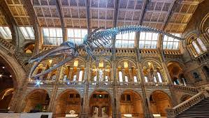
Educational Visits and Performances
We are hoping to have lots of fun trips this year!
Previously we have visited the Gurdwara, been orienteering at Hampstead Heath and been to the Natural History Museum. Further information will follow.
Christmas/Winter performance
Forest School (Spring term)

Slide 25
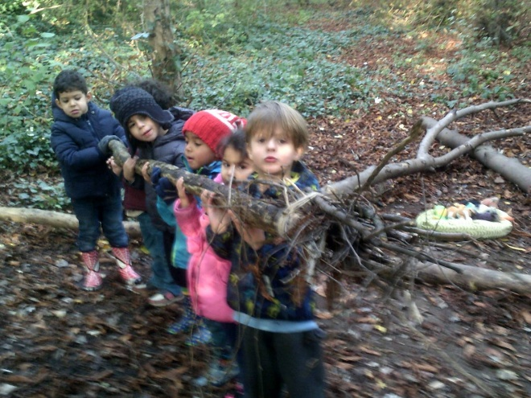
Dates for your diary:
Year 2 and 3 Open Morning: Friday 16th October
Parents Evening:
Parent Evenings 10th and 12th November
Parent Evenings for children on the SEND register 24th and 26th November
Forest School: Spring Term - We will send out all the relevant information just before Christmas. We will need 2 parent helpers per week. One class will go on Mondays and the other on Tuesdays.

Slide 26

Homework:
Homework (letters on a Friday) – suggested activities to support learning in school. (No expectation for these to be returned)
Spellings and handwriting
Quick maths/recall of number facts (WRM app, Hit the Button)
Multiplication tables (TTRS, Hit the Button)
Reading (listening to and reading to)
Talking and playing games (cards, chess, board games).
Real life experience: e.g. shopping and cooking.

Slide 27
Communicating with the teachers
If you need to talk to your class teacher, please let them know at the beginning/end of the day.
N.B. We will not be using the Dojo app or direct emails for contact between us.
If you need to contact the school, please email admin@campsbourne.haringey.sch.uk The office will make sure your message reaches the correct person quickly.

Slide 28

Thank you for coming!

